Slide 1
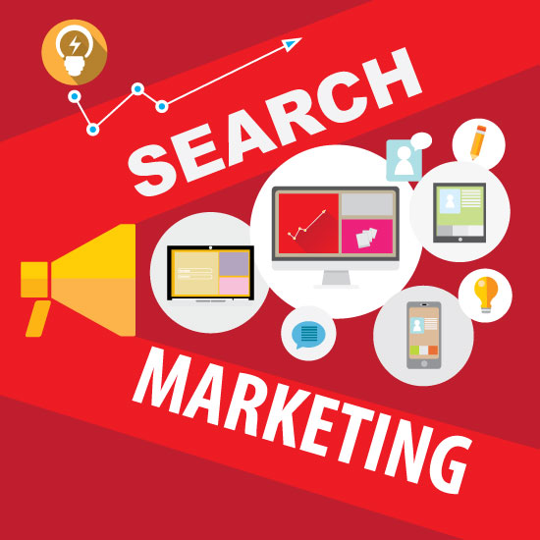
Search Marketing Review
Past, Present and Future

Slide 2
Learning Objectives
Explain the benefits and challenges of an online presence
Define search marketing and related industry terms
Describe how search engines work
Understand developing industry trends

Slide 3

Why would a coffee shop need a website?
The Coffee Shop
Notes:
Does a little coffee shop in _____ really need a website?? Or even an online presence? (Yes!)
According to a recent RBC small business survey, only 46 per cent of Canadian small businesses have a dedicated website, and less than half (48 per cent) of those businesses say they sell their products and services through their websites.

Slide 4


Web Sites
There are over 190 million active websites worldwide*
How will your website get found???
190 Million
Notes:
Think getting found is easy?
Source: Netcraft, August 2019.
You see the answer – what’s the question? Be sure to review file as a slide show to reveal content behind the screen images (this applies to all slide sets).

Slide 5
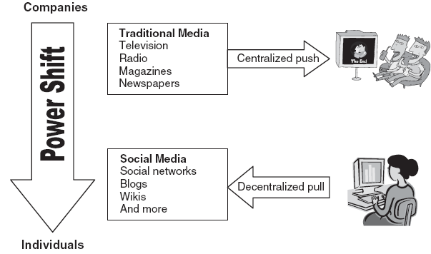

Marketing Then vs. Now
Power shift from sellers to buyers
Consumers trust each other more than companies
Market & Media fragmentation
Online connections critical
Everyone can be a content producer
Information transparency
Social commerce
Inbound Marketing…
Notes:
Market & Media fragmentation => market to one customer
Inbound marketing refers to getting found online (e.g. through social media), as opposed to interrupting customers with outbound marketing that attempts to get them to pay attention to ads.

Slide 6
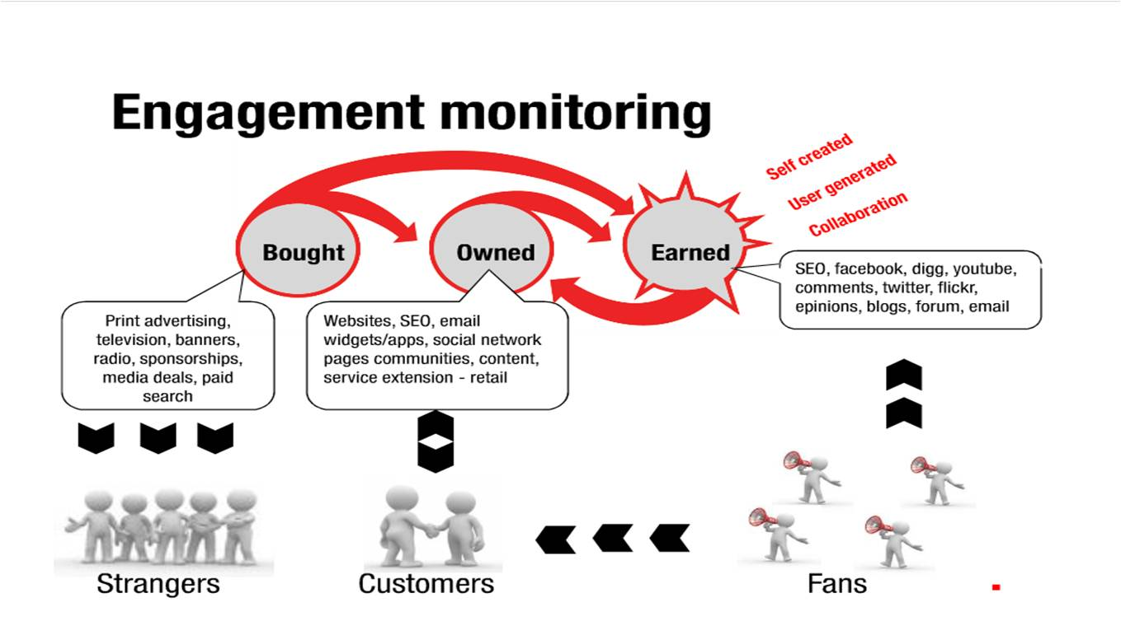
Getting Found Today: POEM
Paid
Owned
Earned
6
Notes:
POEM = Paid, Owned & Earned Media
In this class, we focus on those aspects of POEM related to search, including lead generation and content development (landing pages). We also touch on email campaigns briefly.
Paid media are properties owned by others who are paid to carry promotional messages.
Examples:
Display ads
Sponsorships
Classified ads
Product placement
Social media ads
Mobile ads
Search Marketing (SEM): Paid search
Owned media carry communication messages from the organization to internet users on owned channels. Examples:
Company Web site
Blog
Support forum/community
Podcast
E-mail, text messaging
Online event
Sales promotion offers
Virtual world
Online games
Gifting
Branded mobile apps
QR codes
Location-based marketing
Social network, microblog
SEO – natural/organic
Earned media are when individual conversations become the channel.
Examples:
Digital coverage from
traditional media
Viral marketing
Wikis
Ratings and reviews
Social recommendations
E-mail
Social site discussion
Community discussion
Widgets & social apps
Location-based services
Collaborative content
In this course, we focus primarily on search engine optimization, paid search, and several areas that relate to search such as analytics, lead generation, etc.
Graphic source: Alex Wong, Slideshare: http://www.slideshare.net/wah17/beyond-branding-digital-brand-engagement

Slide 7
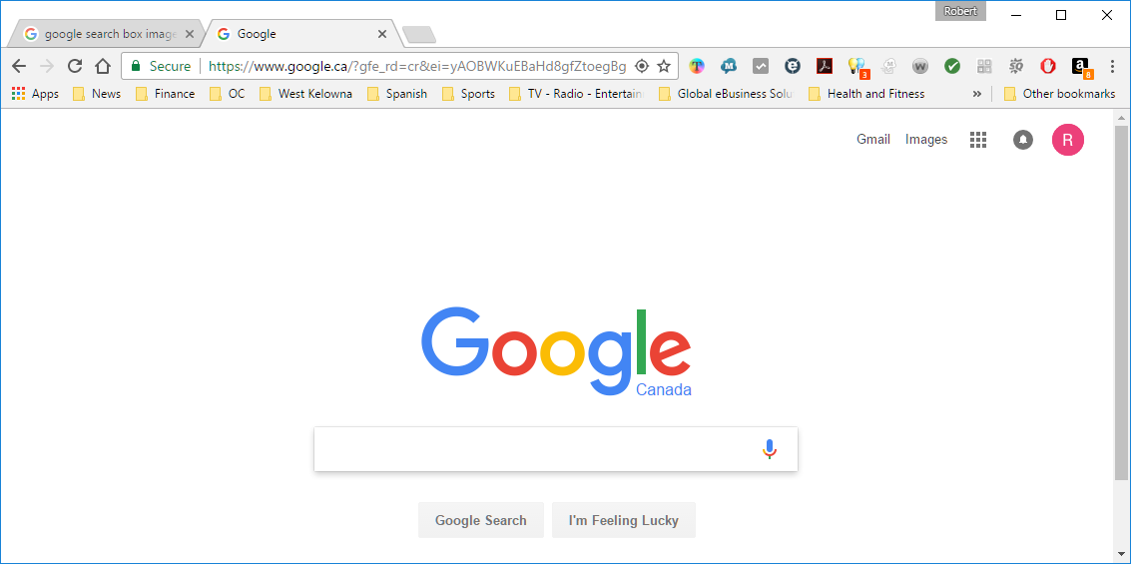


best coffee shop kelowna
*
Notes:
Even if you have created a website and/or online presence for your business/organization, it may be buried in the search listings. How do we get found?
Check out: https://searchenginewatch.com/sew/study/2276184/no-1-position-in-google-gets-33-of-search-traffic-study for more info. on how quickly traffic drops from page 1 to page 2 of search results:
*There is a 95% drop in traffic from search engine results pages (SERPs) on page 2! You want to be found on page 1.

Slide 8

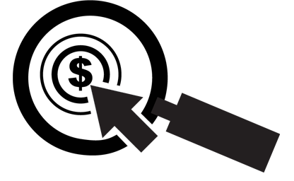
What is Search Marketing?
Search marketing is the process of gaining
traffic and visibility from search engines
Paid Search
Organic Search
Notes:
Organic search (also called natural search) is unpaid.

Slide 9
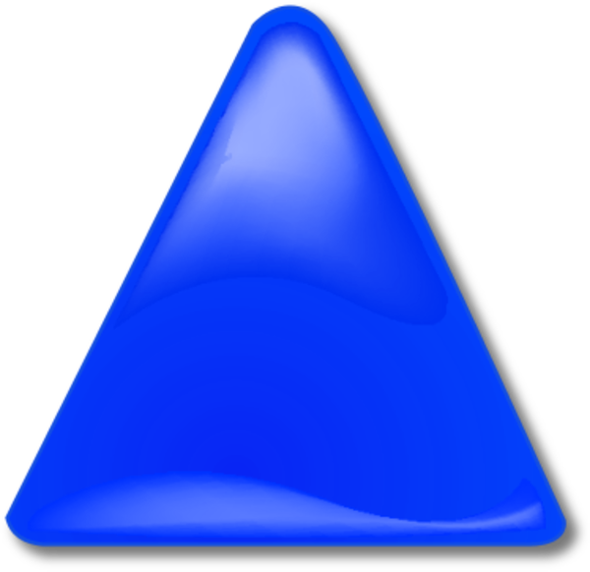
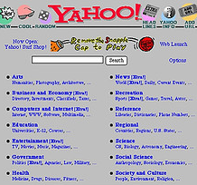
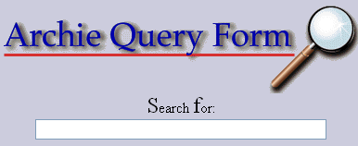
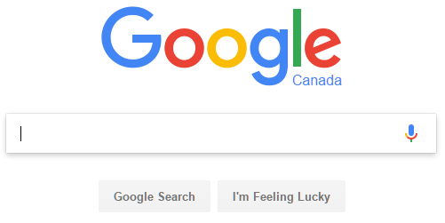
A Little Bit of History
Many,
MANY
more
Notes:
From Archie in 1990, and Yahoo! In 1994, search has come a long way. Archie didn’t index the content of files, just the names.
See http://www.searchenginehistory.com/ for much more detail.
You don’t need to study this for the exam, it’s just fyi…

Slide 10
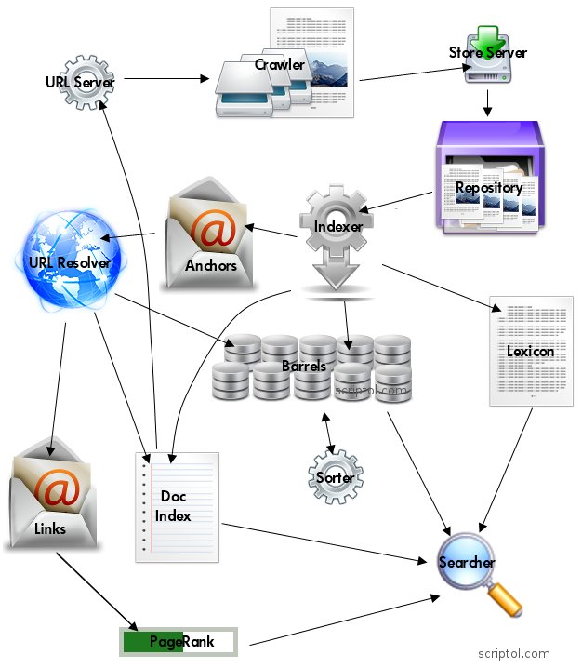

How Search Engines Work*
(Bot, Spider)
Notes:
*How much of this should we know for exams? Just that when you conduct a search, the search engine isn’t doing a real-time search of the entire web, it’s actually performing a database lookup of previously ranked crawl results. In addition, you should understand that links to web pages are important to the search engines. So not all pages on the Internet are searched, just the ones in Google’s database.
Although changes/updates and differences exist in the search engines, this early model from Google gives the user a good idea of the approach that is in use today.
In the field of search marketing, a search engine is a program that searches for and identifies items in a database that correspond to keywords or characters specified by the user, used especially for finding particular sites on the World Wide Web.
The components:
Crawlers (also called bots or spiders): There are several distributed crawlers, they parse the pages and extract links and keywords.
URL Server: Provides the crawlers with a list of URLs to scan.
Store Server: The crawlers send collected data to a store server. It compresses the pages and places them in the repository. Each page is stored with an identifier, a docID.
Repository: Contains a copy of the pages and images, allowing comparisons and caching.
Indexer: Indexes pages for SERPs (results). It decompresses documents and converts them into sets of word occurrences called "hits“ (not to be confused with a web hit). It distributes hits among a set of "barrels". This provides an index partially sorted. It also creates a list of URLs on each page. A hit contains the following information: the word, its position in the document, font size, capitalization.
Barrels: These "barrels" are databases that classify documents by docID (which corresponds to wordID). They are created by the indexer and used by the sorter. They effectively store the hit lists.
Anchors: The bank of anchors created by the indexer contains internal links and text associated with each link.
URL Resolver: takes the contents of anchors, converts relative URLs into absolute addresses and finds or creates a docID.
It builds an index of documents and a database of links.
Doc Index: Contains the text relative to each URL.
Links: The database of links associates each one with a docID (and so to a real document on the Web).
PageRank: The software uses the database of links to define the PageRank of each page (deprecated from public view, however it still factors in to search ranking).
Sorter: It interacts with barrels. It includes documents classified by docID and creates an inverted list sorted by wordID.
Lexicon: A software called DumpLexicon takes the list provided by the sorter (classified by wordID), and also includes the lexicon created by the indexer (the sets of keywords in each page), and produces a new lexicon to the searcher.
Searcher: It runs on a web server in a datacenter, uses the lexicon in combination with the index classified by wordID, taking into account the PageRank and relevance, and produces a results page.
It goes without saying that this scheme is simplified. The system has become increasingly complex over time and added features. Want more info? Go to: http://infolab.stanford.edu/~backrub/google.html.

Slide 11
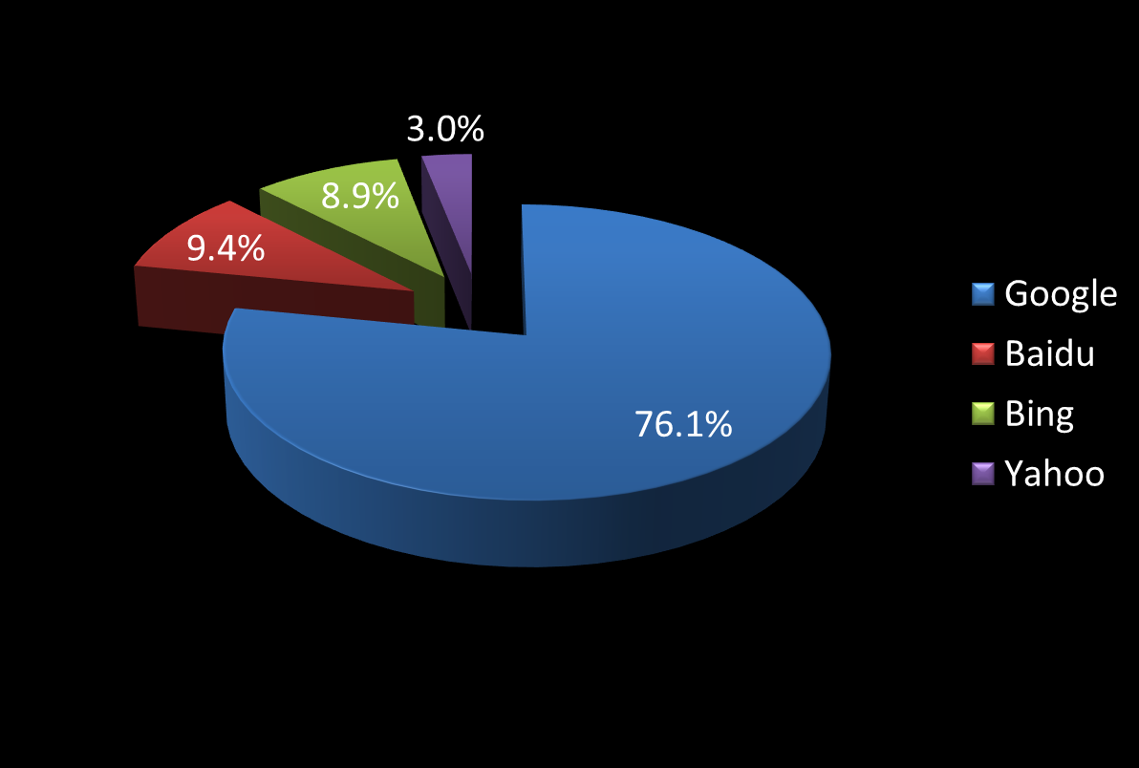
Search Engine Market Share
July 2019 Data (netmarketshare.com)
Notes:
Others have a minor share and are ignored in this chart. Kind of obvious which search engine we should focus on first, right? There may be exceptions for certain regions of the world, however for this region we will focus on Google…

Slide 12
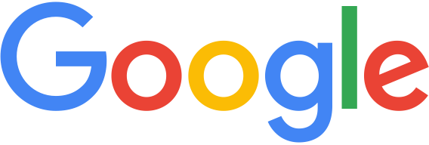



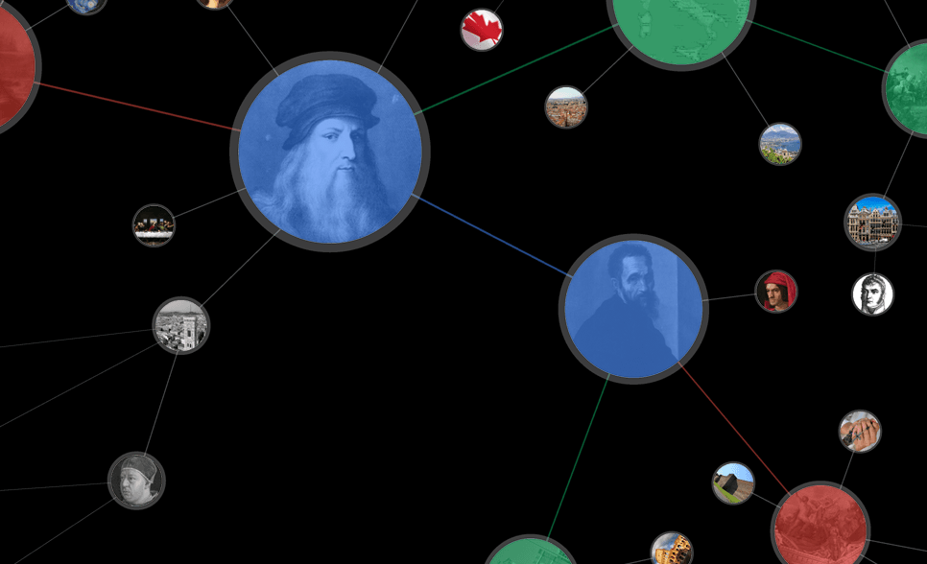


Updates*
Notes:
Google (and the other search engines) are continuously updating their search algorithm in an attempt to improve results.
Panda Highlights:
Penalties for duplicate content, thin content
Bonus for fresh content
Penalty for poor grammar
Stronger boost from social signals, user behavior (e.g. click and bounce)
Consideration of outbound links
Penguin Highlights:
Penalty for over-optimized anchor text
Pigeon Highlight:
Improved local search results
Hummingbird Highlight:
Algorithm replacement (faster, more precise)
Contextual interpretation
Knowledge Graph (click on the image to learn more)
Answers right on the Search Engine Results Pages (SERPs)
Search recommendations as you type
RankBrain
Artificial intelligence applied to search
Mobile First
If site isn’t mobile-friendly (as defined by Google) it is removed from mobile search results
*You don’t need to memorize which items go with which Google updates, but you SHOULD know the key important items from these updates that can impact search results for a small business. For example, grammar/spelling errors are penalized in the rankings, and your site needs to be mobile-friendly.

Slide 13

What Does a Comprehensive Search Marketing Campaign Involve?
Notes:
Conducting a comprehensive search marketing campaign today involves much, much more than it did in the past. The marketing professional must take into account:
What their potential stakeholders are looking for
What methods (and devices) their stakeholders use to find solutions
Content that matches the stakeholders’ search patterns
Efficient linkage between stakeholder searches and the “right” content
Lead generation
Website and social media development that is consistent and synergistic with all of the above
Messaging (e.g. advertising) that targets stakeholders appropriately
Measurement (analytics) to continuously improve

Slide 14


E-Marketing Today: Web 2.0
Search engines are also reputation engines
Image recognition takes root
Intellectual capital and content important
Marketing Strategy
Notes:
Organizations must integrate information technology seamlessly into marketing strategy
Multichannel marketing: Web site, retail store, and catalog
Integration of inventory databases
Integration of customer service across channels
Use of content
Seamless use of social media, websites, apps, mobile, desktop, etc.

Slide 15

The Future of Search
Faster/Better
Semantic Web
Artificial Intelligence will improve
Semantic Web is a group of methods and technologies to allow machines to understand the meaning - or "semantics" - of information on the World Wide Web
Customers will have information, entertainment and communication
when, where and how they want it.
Notes:
Sir Tim Berners-Lee, co-inventor of the World Wide Web, has been working on technology to organize online data for greater user convenience, i.e., the semantic Web. Users will be able to easily find information based on its type.
Stepping Stones to Web 3.0:
- Higher bandwidth
- Faster connection speeds
- Artificial intelligence
- Seamless social networking
- Modular Web applications

Slide 16
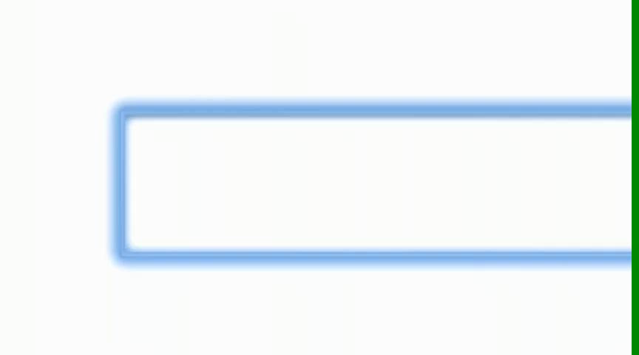
The Semantic Web - Beginnings
Notes:
Hover over image and click on play to play video. This ad from Google showed the very beginning of semantic search capability. It’s getting better all the time, but clearly still has a ways to go to get to the point where the search brings us most or all of the information we want without having to search (or click) further.

Slide 17
Assignment
Text: Read/Review Chapter 1
Start skimming news for relevant articles
Start forming your project team
No Lab This Week!

Slide 18
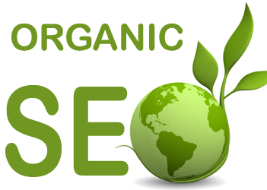
&
Keyword
Development
Search
Focus

Slide 19
Learning Objectives
Explain the concepts of organic search and search engine optimization
Identify the potential market(s) for a company/product
Identify the best keywords for a company/product web page
Determine the weaknesses in a website’s link profile

Slide 20
best restaurant kelowna
Notes:
Even if you have created a website and/or online presence for your business/organization, it may be buried in the search listings. How do we get found?

Slide 21

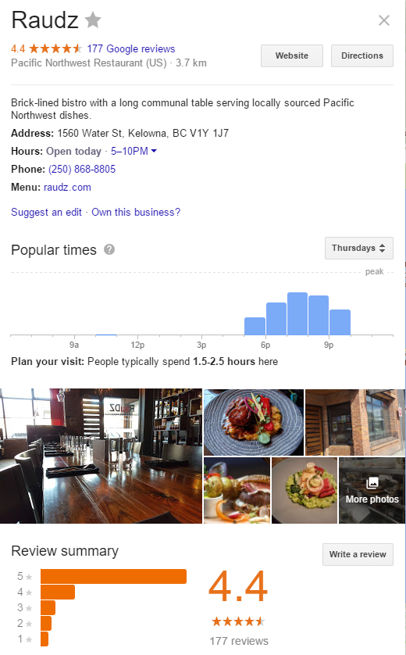
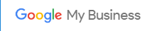
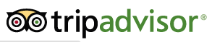
Organic Search
Search Engine Optimization or SEO - involves optimizing a web site and its related online presence so that it ranks well in the search results
Local search*
Vertical search
Notes:
Organic search is one way to get found! Remember that organic search, or natural search results can’t be purchased.
Google My Business allows organizations to put their business on the Google Map and in the local search results for a given search. Register a business at: https://www.google.ca/business/. Google posts are an opportunity to enhance your local search results, with current information and incentives.
Vertical search is site-specific search on specialized topics, such as travel or books that helps users find what they are looking for quickly. CareerBuilder is another example of vertical search.
How Google determines local ranking:
*Local results are based primarily on relevance, distance, and prominence. These factors are combined to help find the best match for your search. For example, Google algorithms might decide that a business that's farther away from your location is more likely to have what you're looking for than a business that's closer, and therefore rank it higher in local results. (See https://support.google.com/business/answer/7091?hl=en for more info.)
Contextual search ads are the basis for Google’s AdSense program.

Slide 22

Keyword Targeting
Relevance
Current Ranking
Traffic
Competition
Notes:
Remember, when people search the Internet, they enter a keyword. A keyword, in the context of search engine optimization, is a particular word or phrase that describes the contents of a Web page. It’s the search term that people enter when they are looking for something on the Internet via a search engine.
Current ranking matters if you already have a website. If your company ranks #1 for the keyword “French restaurant in Kelowna”, #14 for “best restaurant Kelowna”, and #286 for “great restaurants in the Okanagan”, and all other factors are equal, which keyword do you want to add marketing effort/dollars to? The answer may surprise you. It would take a relatively massive effort to get #286 onto the first page, so given that all other factors are equal, it would be better to put some marketing effort into getting that #14 term onto the first page.

Slide 23

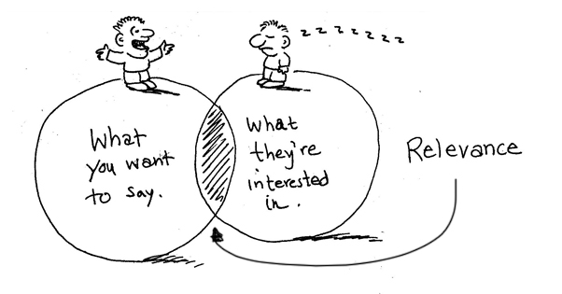
How is Relevance Relevant?
Notes:
When dealing with search engines, the term ‘relevance‘ describes the extent to which the content of a website corresponds to the search term used. The relevance of a website’s content is particularly important for search engines; it affects how high a website will appear in the search results for a given search term. Your landing pages MUST be contextually relevant to the visitor search terms if you want your site to experience conversions (to a particular goal, e.g. sales).
Source: adapted from searchmetrics.com and seoblog.com.

Slide 24
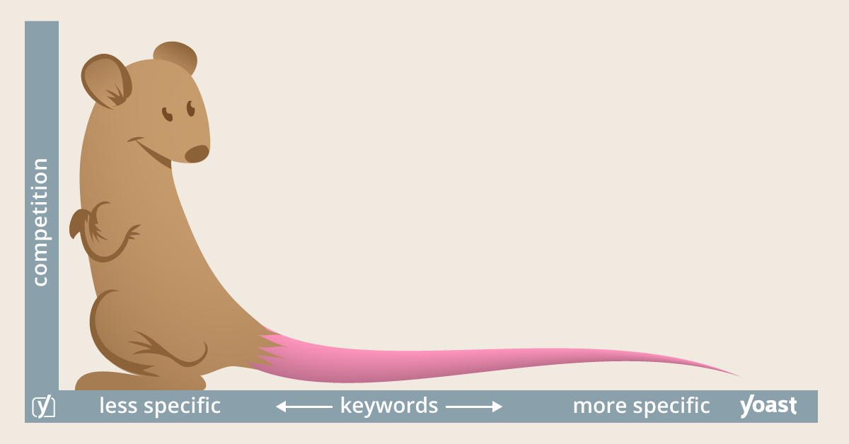
Long-Tail Keywords
Relevance
Notes:
Here’s a fat head (short-tail) keyword: cookbooks
Here’s a long-tail keyword: latin dessert cookbooks
Fat head (less specific) keywords get more traffic. Long-tail (more specific) keywords get higher-quality traffic. Remember this when you get to the paid search simulation!
Note that a keyword can be a single word or a phrase! So the phrase “latin dessert cookbook” is a keyword, not keywords. The “keyword” is whatever the searcher enters in the search box.

Slide 25
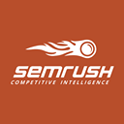



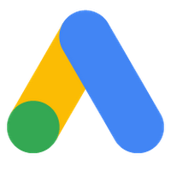
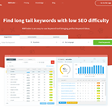
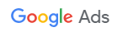
Traffic & Competition
Moz
KWFinder
Notes:
In order to use Google’s keyword planning tool, you’ll need to create a Google Adwords account. This is free (although placing ads is NOT free), and is tied to your gmail account (if you have one). Go to: https://adwords.google.com/ if you wish to create an account. (Warning: Google has intentionally made it a bit painful to get to their keyword planner – you will have to complete profile information on your business, and walk through the ad wizard. It won’t cost anything but time, however, if you don’t activate ads. You don’t need to create an Adwords account for this class.) Google also offers a search console tool that can provide valuable (and free) information about your site(s).
We can also use other tools to do keyword research. SEMrush is one of the top tools used by experts in the industry, and is what we will use the most in this course as long as they continue to give us free access. Keyword Finder is also shown, and it will let you perform a small amount of work for free (called a Freemium business model). Moz Keyword Explorer will also let you do a small amount of work for free (as of this posting, up to two queries per day). Keyword Tool also may be helpful. Finally, if you perform a search for keyword tools, you’ll find many more options.
Another popular tool is LongTailPro, however it has a very limited free trial, so we won’t use this directly in class.

Slide 26
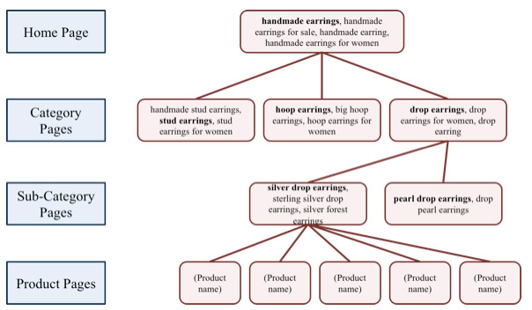
Keyword Mapping
Notes:
It’s a good idea to plan your keywords to match specific pages on your website. The search engines are really picky about this, so you should be too (remember relevancy?)

Slide 27
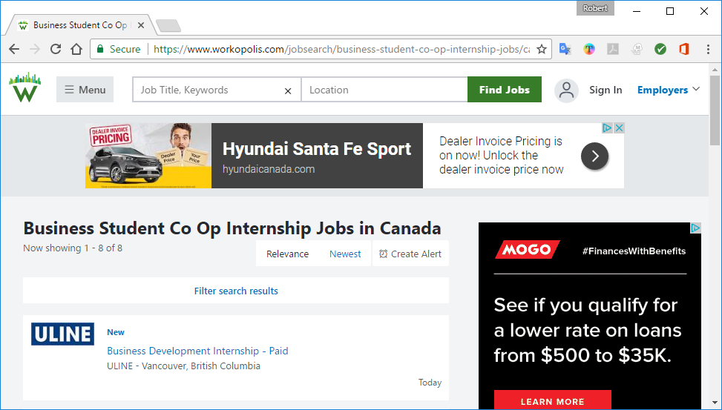
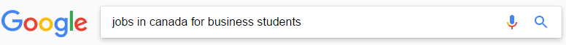
Keyword Usage
On-page
SEO
URL
Title Tag
Description Metatag
Header Tags
Main Content
Alt Text
Anchor Text
Notes:
Keyword usage used to be one of the most important elements of SEO. Today, it still matters, however it is just one of many variables in-play. Search engines are also more intelligent, so having quality content about your keyword topic is superior to “stuffing” the exact-match keywords into the text. In fact, your site can be penalized for keyword stuffing. Make sure you understand each area listed above where keywords come into play. Your text has more information, or you can perform a quick search to learn more.

Slide 28
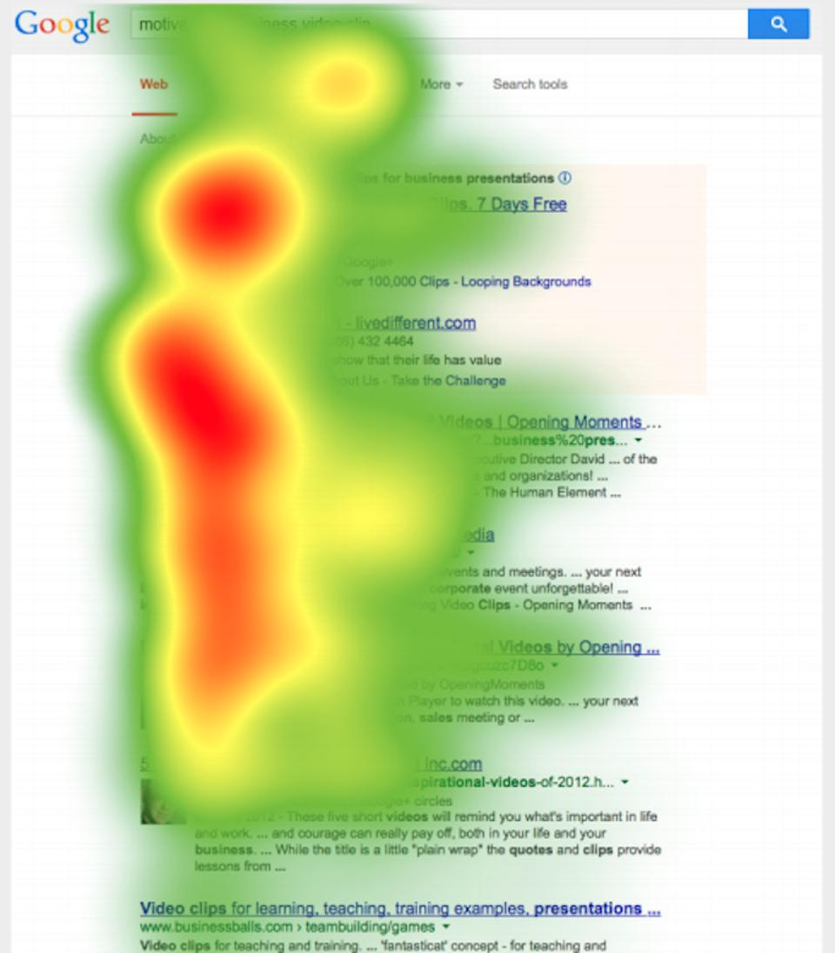
Search Engine Heatmap
Notes:
User eye-tracking studies have shown that the upper left gets the most attention in search results, but searchers still scan down the left side a little to get the information they seek.
http://www.forbes.com/sites/roberthof/2015/03/03/how-do-you-google-new-eye-tracking-study-reveals-huge-changes/2/#74c182961650

Slide 29
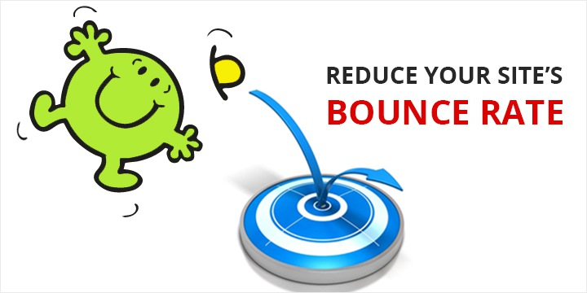
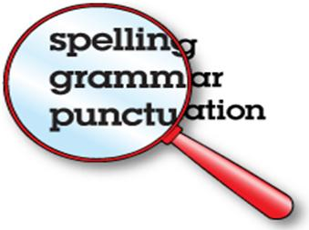
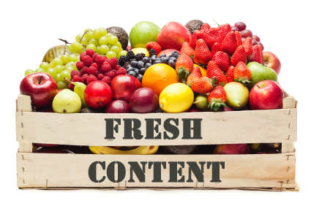
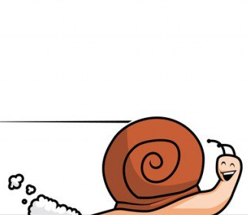

Quality from a Search Engine Perspective
SLOW
LOAD
TIME
Original
Quality
Notes:
Bounce rate = the percentage of visitors to a particular website who navigate away from the site after viewing only one page. See https://support.google.com/analytics/answer/1009409 for Google’s discussion on bounce rate.
Use Google’s PageSpeed tool and Pingdom (search for the names to find these free tools or look for others) to find a site’s load time.
“2 seconds is the threshold for ecommerce website acceptability. At Google, we aim for under a half second.“ (Maile Ohye, from Google 2010)
Don’t forget that quality content includes unique, well-crafted title tags and description metatags for each page of your website!

Slide 30

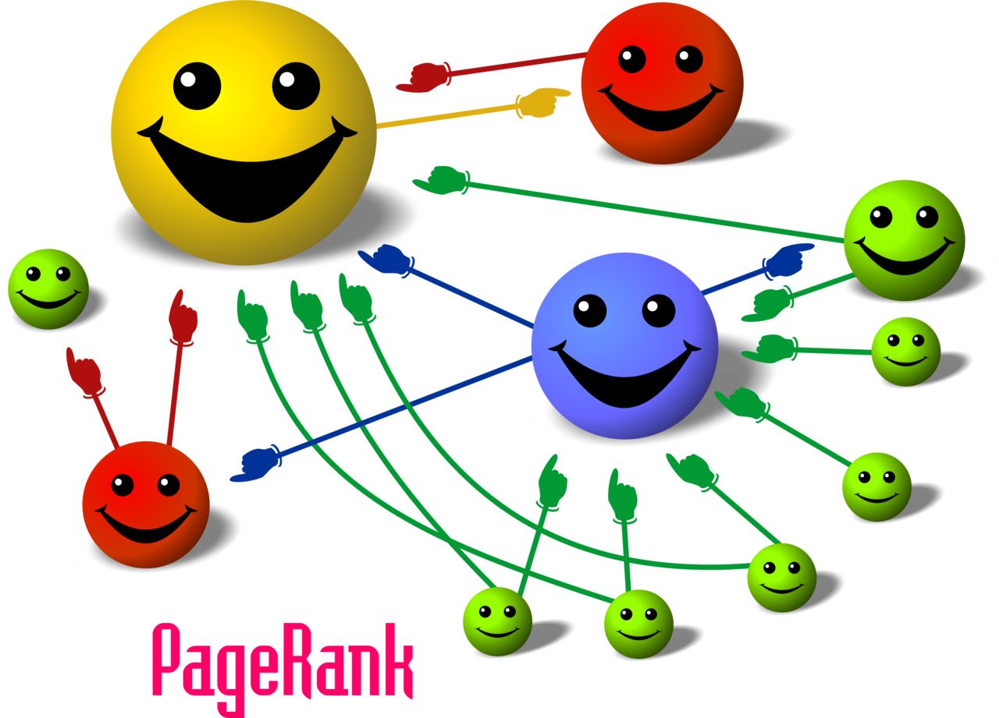
So what’s this PageRank thing??
Notes:
What Is PageRank?
PageRank (PR) is a calculation, famously invented by Google founders Larry Page and Sergey Brin, which evaluates the quality and quantity of links to a webpage to determine a relative score of that page’s importance and authority on a 0 to 10 scale.
The handful of PageRank 10 domains, including USA.gov, Twitter.com and Adobe Reader Download, have the highest volume of inbound links of any sites on the web. The top sites set the bar, so to speak, and the 10-point scale plummets exponentially down from there.
PageRank 5 websites have a good number of inbound links, PR 3 and PR 4 sites have a fair amount, and brand new websites without any inbound links pointing to them start at PageRank 0.
NOTE: You may be curious what your site’s or your competitor’s PR score is. But Google no longer reveals the PageRank score for websites. It used to display at the top of web browsers right in the Google Toolbar, but no more. And PR data is no longer available to developers through APIs, either. Even though it’s now hidden from public view, however, PageRank remains an important ingredient in Google’s secret ranking algorithms.
Sources: adapted from bruceclay.com/blog and CC BY-SA 2.5, https://commons.wikimedia.org/w/index.php?curid=2776582.

Slide 31
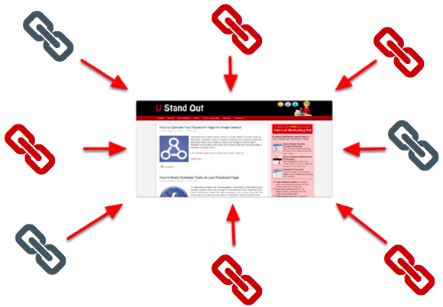

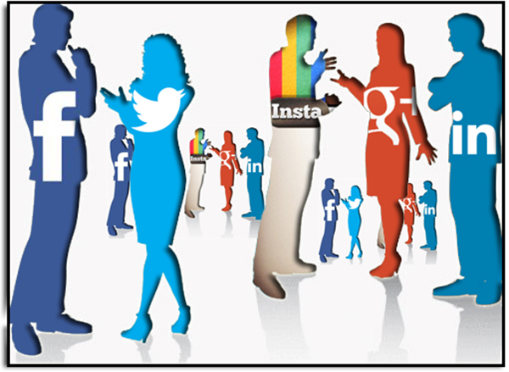
Popularity Metrics (Links)
Offsite SEO
Backlinks
Anchor text
Social sharing
Notes:
Note that backlinks are not just about getting lots of links to your web page. The relevance and quality of the sites they come from matter, the anchor text (text used in the link URL) matters, the freshness of the links matters, and the diversity of the links matters.
We are also more interested in referring domains than total backlinks. This is because total backlinks doesn’t tell you how many backlinks are coming from the same domains (websites). What if all the backlinks are coming from one “link farm” (one domain that sells backlinks)? That would be bad for your site, and would get you penalized by the search engines.
There are various ways to develop backlinks to your site:
Linkbait (fresh quality content that other sites want to link to) – Most valuable!
Manual links (requested from a related site, or submitted to a directory, etc.)
Manufactured links (electronic signatures, etc.)

Slide 32
For Next Week
Although we’ve covered some big ones, there are many additional factors that can impact search ranking
Optional Assignment: go to moz.com (or perform an internet search) and review the latest Search Engine Ranking Factors. Pick one not discussed yet to summarize in your own words for class next week for an EXTRA participation mark!
Notes:
Optional assignment counts towards participation.

Slide 33

Assignment
Text: read Chapters 4,5 + posted materials
Keep skimming news for relevant articles
Form your project team & sign up for presentation
Lab: Google Online Marketing Fundamentals Certification (due Sep. 30)

Slide 34
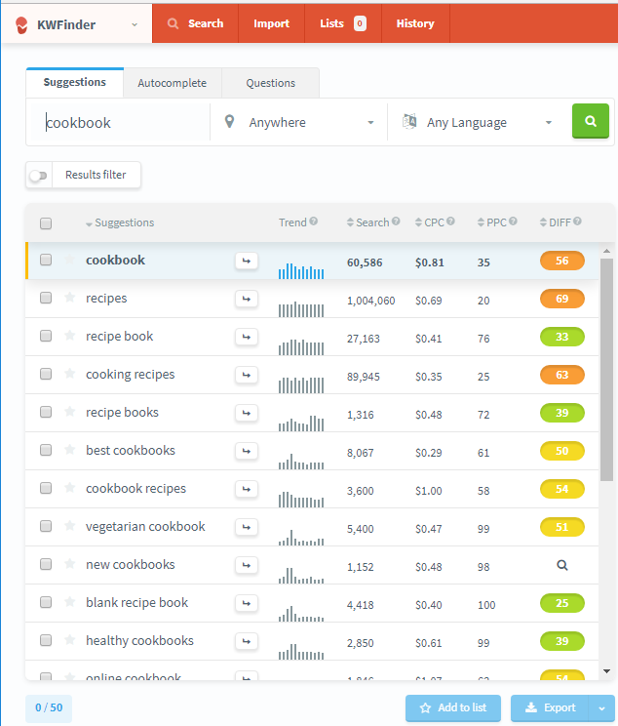
Reference Slide - KWfinder Example
Notes:
This shows an example of the results from KWfinder.
Lots of people search for the keyword “cookbook”. Does that mean it’s a better choice than a long-tail keyword with less traffic if you are selling a latin dessert cookbook? NO!

Slide 35

Web Design for
Landing Pages
Notes:
In this course, we are only interested in those aspects of web design that relate to getting found! So we won’t be building websites, just planning content/navigation, etc. and critiquing existing pages consistent with current best practices.

Slide 36
Learning Objectives
Landing Pages
Understand and utilize multiple design philosophies to design webpages to maximize conversion rates
Identify the various types of landing pages
Analyze existing landing page content and identify opportunities for improvement

Slide 37

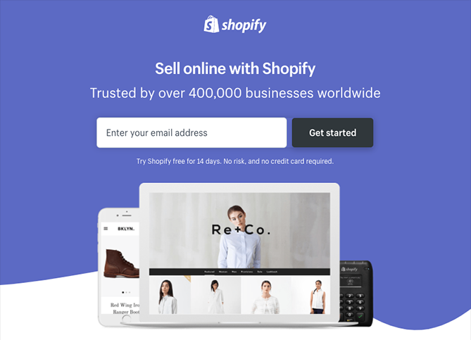
What’s a Landing Page?
A single web page
that appears in response
to clicking on an organic search result or an online ad
Notes:
Play as PowerPoint show to reveal text beneath graphic.
This should be review, but let’s make sure everyone has the same understanding! Some sites define a landing page using more restrictive terms, however this definition is in common use in the industry and best suits our general purpose of search marketing.

Slide 38


What % of Canadian Small Businesses have a Dedicated Website?*
50%
46%
Notes:
As a lead-in to the topic of Web design & Landing Pages, can you answer this question?
*Scroll down for the answer.
*According to a recent RBC small business survey, only 46 per cent of Canadian small businesses have a dedicated website, and less than half (48 per cent) of those businesses say they sell their products and services through their websites.

Slide 39
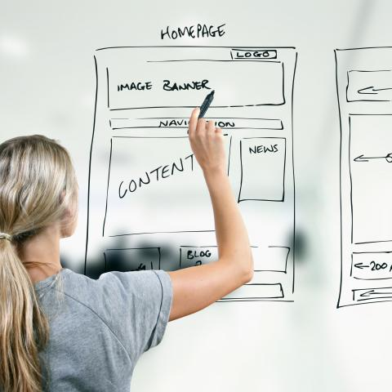
User Experience Studies
Optimizing
Conversion
Notes:
Try searching for something, and then click on one of the results in the search engine results page. Can you get the information you want? How many clicks did it take? Did you “bounce” back to the search results because the landing page was not what you were looking for?
Performing a simple user experience study with some potential clients can quickly identify problems with your landing pages for specific keyword terms.

Slide 40


Design for Usability
Convention
Eliminate Distractions
Clearly Defined Areas
Effective Visual Hierarchy
Format Content for Visual Scanning
Notes:
Have you visited a website where it was difficult (or seemed impossible) to get the information you were looking for? Many business owners design websites based on their organizational preferences, instead of designing it for their key stakeholders.

Slide 41

Design for Conversion
Clarity/Congruence
Context
Desired Action
Credibility
Closing
Continuance
What? Why? Next?
Notes:
Your website landing pages need to clearly answer the “questions” that your site visitors have. For example, who are you and what are you offering? Why should I pick you? What do you want me to do next? (Source: Unbounce)
Desired Action. What is the action you would like potential customers to take? Does everything on the page point to this action (figuratively or literally)? In other words, is there a single call to action (often abbreviated CTA) that attracts users' attention?
Context. Where are site visitors coming from? Does the message and content of the homepage match the expectations of customers?
Clarity. Is it clear from a quick scan of the webpage what the webpage is about? Does the user know what will happen once he or she clicks a link?
Congruence. Do all the words on the webpage encourage the conversion or do some words distract potential customers from the desired behavior?
Credibility. Do potential customers have ample reason to believe you can deliver on your promises?
Closing. Use positive messaging close to the desired click region. Negatively-valenced words can sometimes inhibit clicking.
Continuance. Once you’ve obtained the desired conversion, does the customer know they’ve completed the intended action and are they being encouraged to begin the next conversion?
We are, of course, assuming that you are bringing the right audience (target market) to the right landing page!

Slide 42
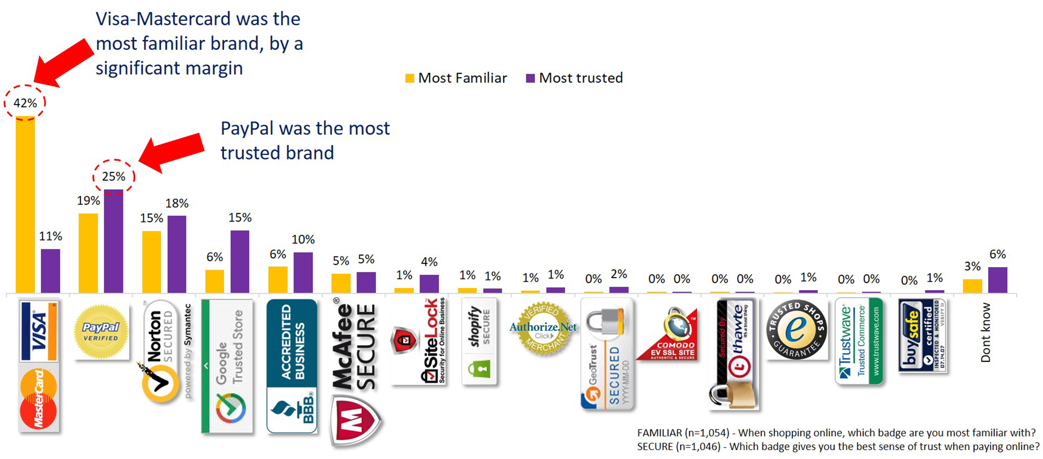
Important Elements in a Website
Navigation
Colors vs. Contrast
Buttons
Images & Video
Trust Symbols
Forms
Phone Numbers
Relevant Content
Notes:
Trust symbols include third-party certifications, such as Better Business Bureau, and any other element that can help build visitor trust with the landing page content owner.
Graphic source: ConversionXL Institute, 2018.

Slide 43

Landing Page Types
Reference landing pages present relevant information
Transactional landing pages attempt to convert visitors into customers
NSAMCWADLP
Hint: Landing Pages need segmentation too!
Notes:
(Play as Powerpoint Show to reveal background content.) Never start a marketing campaign (online) without a dedicated landing page. Remember, in online marketing, a landing page, sometimes known as a "lead capture page" or a "lander", or a "destination page", is a single web page that appears in response to clicking on a search engine optimized search result or an online advertisement. The Web site is a door into a company and must provide inviting, organized, and relevant content.
Microsites are Web sites designed for a narrow, specific purpose
A microsite is a small but complete supplementary website used for fairly large campaigns. They will normally have their own vanity URL related to the timing and relevance of the campaign. Even though it’s more than a single page, it’s still classified as a landing page as it’s a destination where customers are driven from paid online ads as well as print and TV advertising.

Slide 44
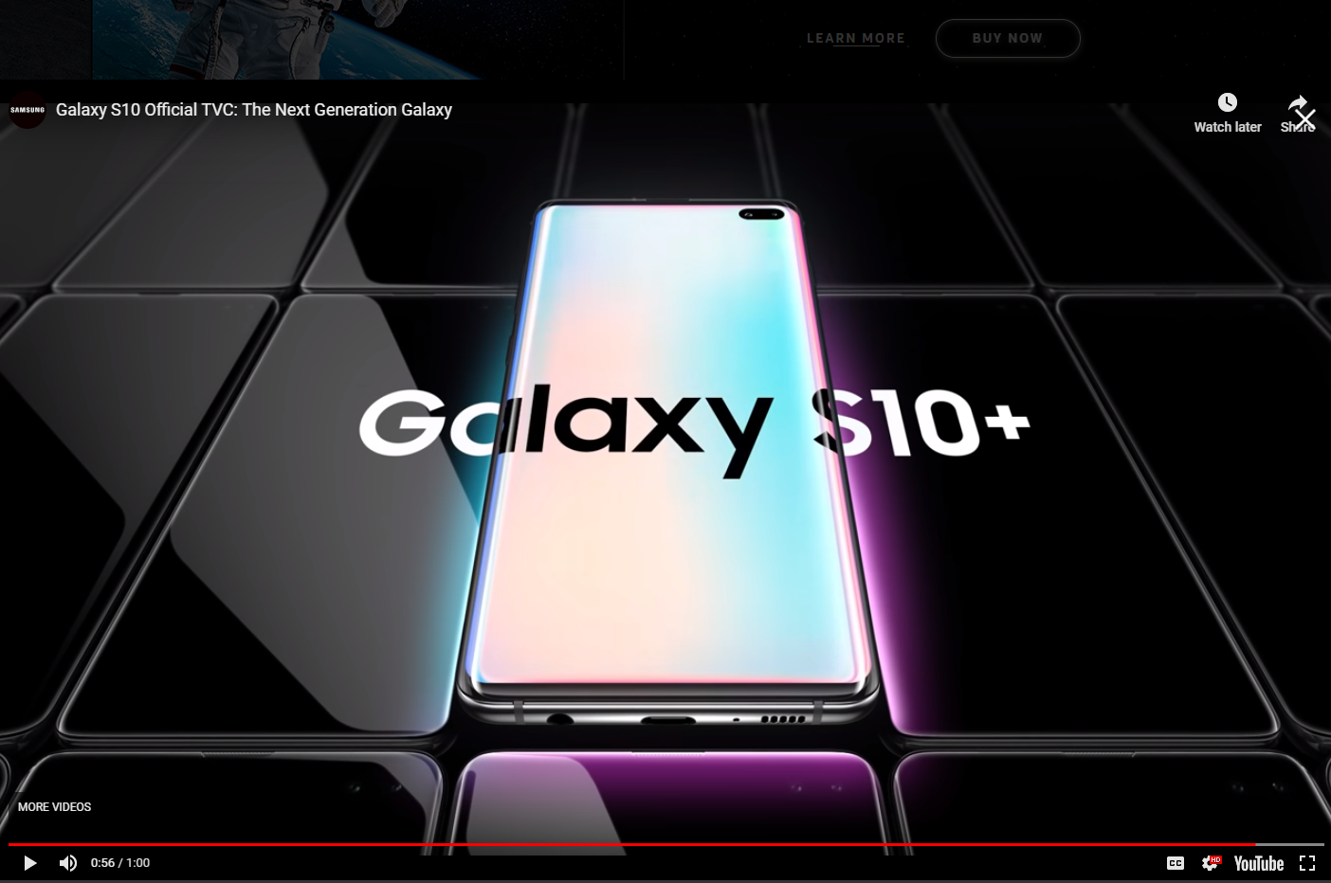
Single Product Landing Pages*
Notes:
*Here are some key elements for single product landing pages:
Product image
Unique value proposition (UVP)
Call to action
How to proceed (our next question)
Familiar color scheme & logo
Ideally, all of the above should be in the upper-fold.
How much does the above page include above-the-fold? A strong brand may be able to take some liberties with content placement, but these elements come from industry best practices.

Slide 45
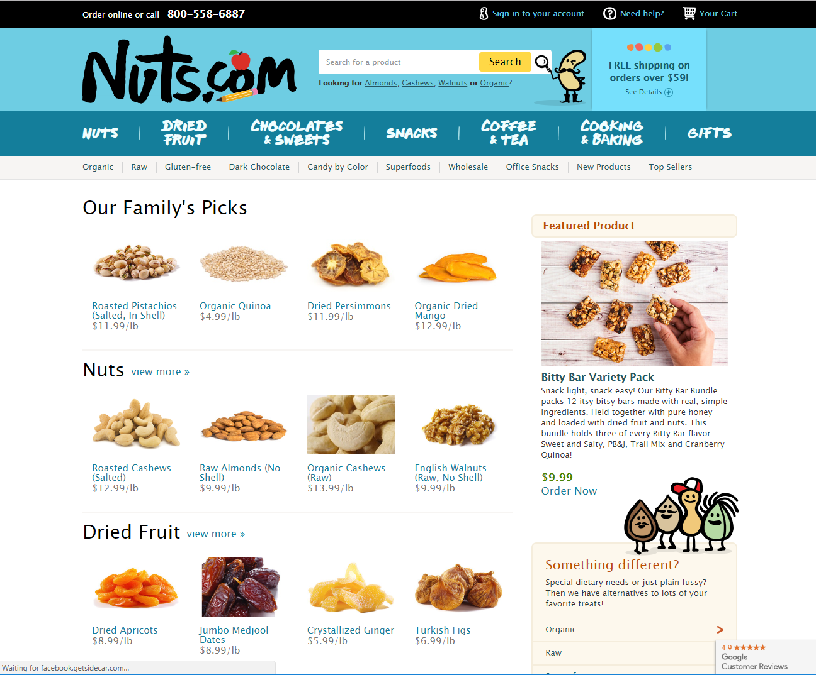
Multi-product Landing Pages*
Notes:
*Best sellers, and best margin products should generally go on top!

Slide 46
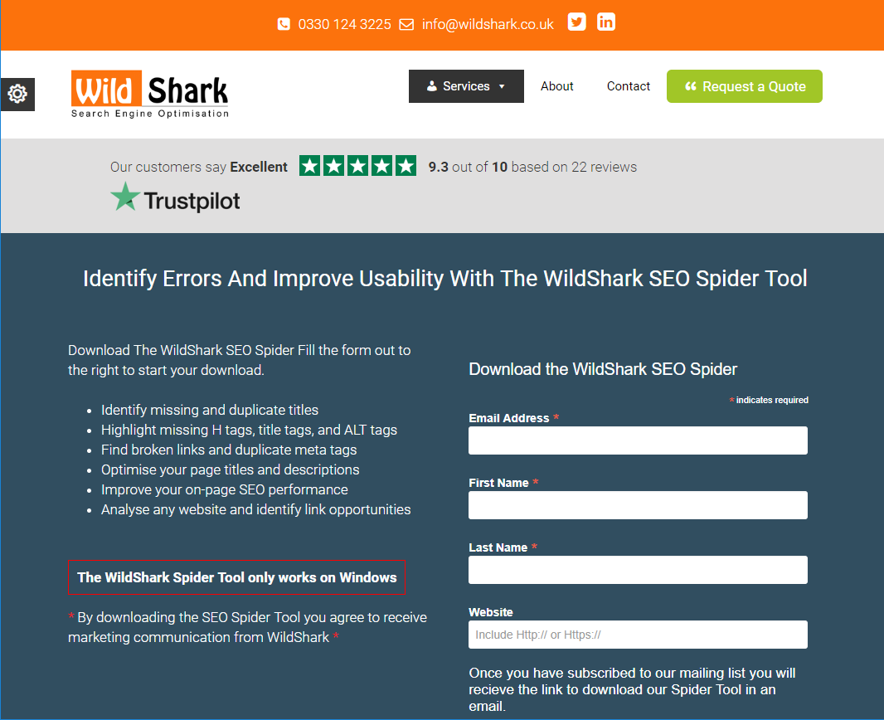
Lead Generation Landing Pages*
Notes:
*Note the form on the page used to collect leads. You can also use forms for newsletter sign-ups, account creation, etc.

Slide 47
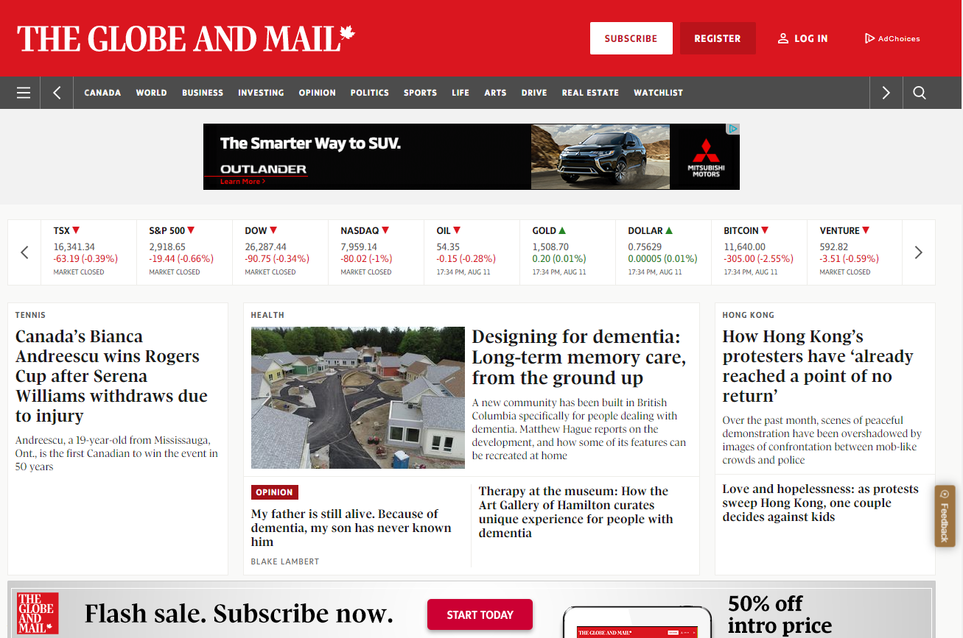
Subscription Sites*
Notes:
*Subscription sites are a common type of transactional landing page. Many of these sites use the proven freemium model, where some content or usage is free, but you have to pay to get full access (paywall).

Slide 48
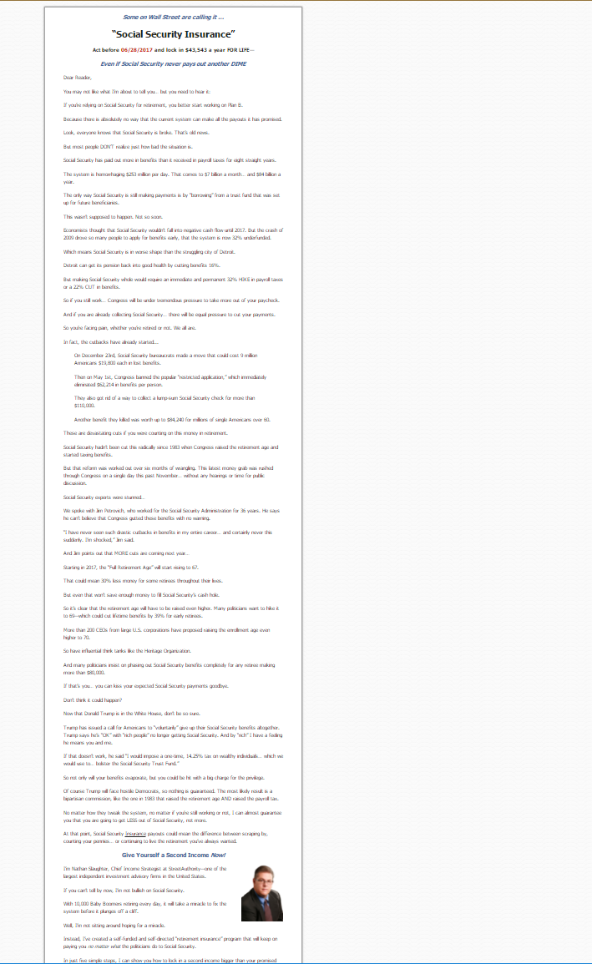
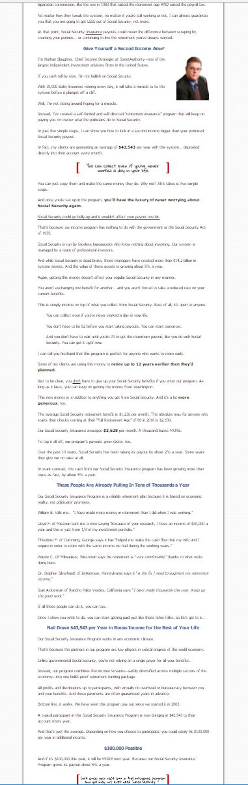
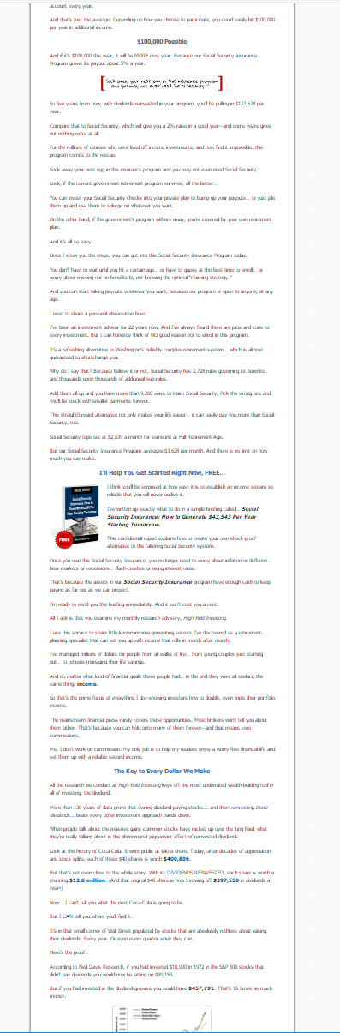
Copy Landing Pages*
Long
Streetauthority.com
Notes:
*Search engines have tended to reward significant content in the past, though such practices today (stuffing excessive content) are unlikely to benefit a company. There is one additional psychological advantage of this approach however: by the time a person gets to the bottom, they’ve invested a significant amount of time researching this site. This time investment has been shown to increase the chance of a purchase for some items (e.g. research reports).
The above example, though minimized, is only a portion of the website found at https://web.streetauthority.com.
Common practices:
Main call-to-action in the upper-fold
Repetition of the call-to-action as the user scrolls down
Engaging content
Varying content (could include video, images, specs, trust symbols, testimonials)
Common design theme throughout

Slide 49

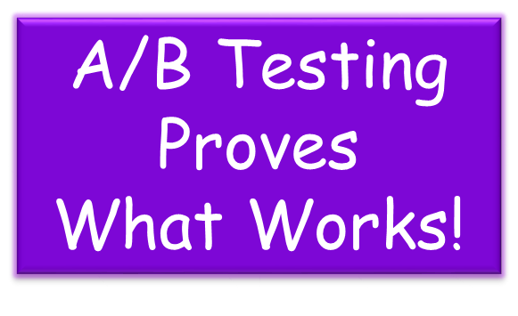
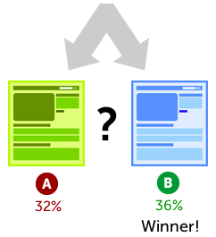
Optimizing Conversion Rates*
Notes:
*Although we do know many best practices, it’s not always obvious which page design is better. Sometimes, there are surprises! A/B testing allows us to quickly test our ideas, to see what actually works best in our situation. A/B testing (sometimes called split testing) is comparing two versions of a web page or ad to see which one performs better. You compare two web pages/ads by showing the two variants (let's call them A and B) to similar visitors at the same time. The one that gives a better conversion rate, wins!
Sites such as abtest.io provide a web-based tool for easier A/B testing.
See https://www.abtasty.com/blog/category/ab-testing/ for lots of additional info. on A/B testing.
Conversion rate = (total conversions/total site visits) * 100%
Some items that can improve conversion rates:
decreasing the bounce rate and shopping cart abandonment
price discounts
promotions
one-day sales to create deadline urgency
new products
streamlined payment process
shipping specials
improved product information
information that helps visitors easily compare products and services
improved navigation and filtering
good site search
good product reviews
good product imagery

Slide 50
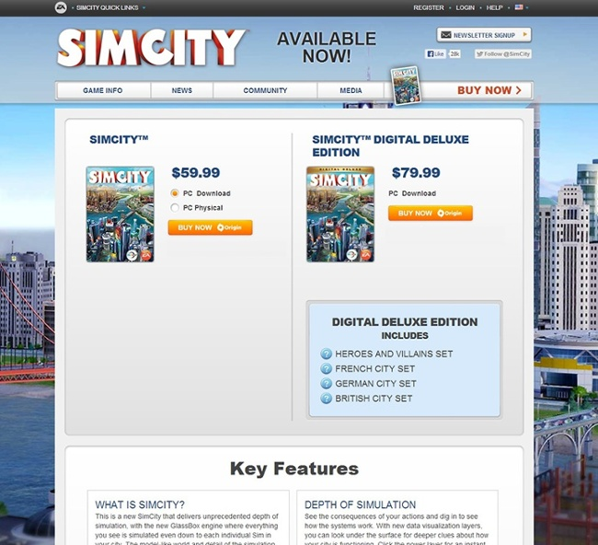
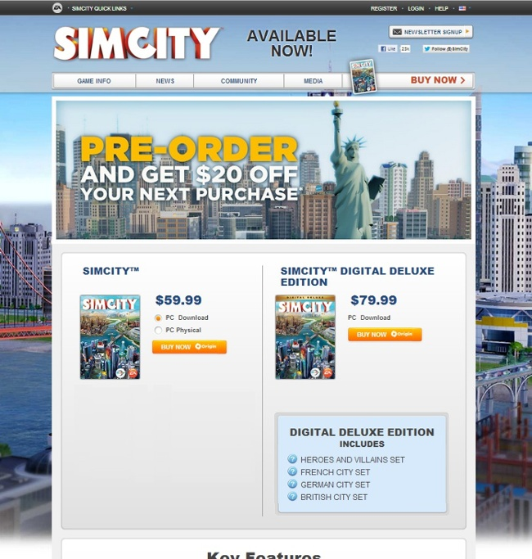
A or B?
A
B
Notes:
Which landing page sold more product for Electronic Arts, A or B? Scroll down for the answer.
The variation with no promotional offer messaging whatsoever (A) drove 43.4% more purchases. Turns out people really just wanted to buy the game -- no extra incentive necessary. Most people believe that direct promotions drive purchases, but for EA, this turned out to be totally false. Testing gave them the information needed to maximize revenue in a way that would not have been otherwise possible.

Slide 51


Which Variation is Best?
Notes:
The original is shown on the top-left. The question was which social proof (testimony from a client) worked best. The original is in the vertical grey box. Variations 2 & 3 use a horizontal testimony box, one with a logo and one without a logo. Variation 1 has a vertical testimonial with a logo. Were any of the variations better than the original? Scroll down for the answer.
Variation 1 increased the conversion rate of the product pages by 69%.

Slide 52

A or B?
Notes:
Another trick question: which one worked better – with standard navigation or without? Scroll down for the answer.
Removing navigation produced a 100% increase in conversion rate.

Slide 53

Ad Publishing Heatmap for Landing Pages
Notes:
Certain locations tend to be more successful than others. This "heat map" from Google illustrates the ideal placing on a sample page layout. The colors fade from dark orange (strongest performance) to light yellow (weakest performance). All other things being equal, ads located above the fold (no scrolling to get to content) tend to perform better than those below the fold (where you have to scroll to get to the content). Ads placed near rich content and navigational aids usually do well because users are focused on those areas of a page (Google).

Slide 54

Conversion Sabotaging Words*
Notes:
*In general, the best CTA’s are as specific and actionable as possible. That means you start with a verb, or action oriented word, that describes what a person’s going to get (e.g., “Click Here to Get My Report”). (Source: Wordstream, 2017)

Slide 55

Markup Data
Notes:
What is Structured Data Markup? HINT: it’s related to our demonstration of semantic search (from the intro. slides). Click on the image to go to Google’s helper tool to see how markup data works.
Technical answer: Structured data is added directly to a page's HTML markup. Search engines use structured data to help generate rich snippets, which are small pieces of information that will then appear in search results.
Detailed explanation from Moz: In an SEO context, "structured data" usually refers to implementing some type of markup on a webpage, in order to provide additional detail around the page’s content. This markup improves the search engines’ understanding of that content, which can help with relevancy signals and also enables a site to benefit from enhanced results in SERPs (rich snippets, rich cards, carousels, knowledge boxes, etc.). Because this type of markup needs to be parsed and understood consistently by search engines as well as by people, there are standardized implementations (known as formats and/or syntaxes) and classifications of concepts, relationships, and terms (known as vocabularies) which should be used.
Search for examples, and it will be much easier to understand what markup data does for your landing pages!

Slide 56


Tool Assistance
Notes:
As you might expect, Google offers a tool to help optimize your website for customers (and other stakeholders). It allows you to perform A/B testing and more!

Slide 57


Assignment
Book: Read Chapter 2
Lab: Landing page assignment (in-class!*) & finish Google Digital Garage certification
Have you formed a project team and signed up for a presentation slot?
No News Ideas Yet?
Check the provided news links in Moodle! It’s easy to find a story…
Notes:
*NOTE: you need to be present in class to do this lab! Please try to be at class on-time, as we will start on the lab right away!!

Slide 58

Analytics
Notes:
Note that there is a difference between digital analytics and web analytics. If you don’t know the difference, perform a Google search on the subject.

Slide 59

Learning Objectives
Explain how analytics work
Select the best KPIs for a website of any variety
Determine the most needed improvements for an eCommerce website based on an analysis of its conversion funnel
Describe the strengths and weaknesses of the various attribution methods
Notes:
KPI = Key Performance Indicator (a quantifiable measure used to evaluate the success of an organization, or a particular activity.)
Note that KPIs are the metrics you will choose for your term project company. If they were to implement your recommendations, they would be able to measure the improvements made by tracking the KPIs before, during and after implementation.

Slide 60



How Does Google Analytics Work?*
Javascript
Or
Google Tag Manager
Google Analytics
Notes:
*GA uses a programming language called Javascript to transmit information to Google's servers about site visitors.
Nearly twenty years old, Javascript is an (almost) universal language that allows coders and developers to make sites interactive. You may know that when you see a website, the text, images, and other information contained in a page are saved in HTML format, which your browser decodes and displays. An easy way to think about this is that HTML is like the .doc file format used for Microsoft Word Documents. Like a Word Document, an HTML file can tell the computer what text to display, where to include images and tables, and what formatting to use. But unlike a Word document, HTML pages are read-only. This means that, without the help of a language like Javascript, an HTML page won't let you do much interacting with a site; you can't change text and your computer can't communicate with a server. Javascript gets around that limitation. Because it is a standardized language, a strong majority of browsers can take instructions written in Javascript and provide additional interactivity. Everything from flyout menus to popup windows are possible thanks to Javascript. But importantly for Google Analytics, Javascript allows your computer to send and receive messages to other computers connected to the internet. When you visit a site that has implemented Google Analytics, the site will ask your computer to temporarily download some Javascript instructions from Google Analytics. That code, in turn, will ask your browser to send some important pieces of data to Google's servers. These data include the specific web page that you are viewing, some technical information about your computer (such as if you are using a Windows or Mac machine), how you arrived at the site, and the way that you navigate throughout its pages. (Source: https://www.digitalthirdcoast.com/)
How to set up analytics tracking (Google): https://support.google.com/analytics/answer/1008080?hl=en

Slide 61



Website Goals
View Landing Page
?
?
Thanks!
Notes:
Similar to the classic marketing funnel, there is a systematic path, or approach that website owners would normally like visitors to pass through to achieve some goal. It may start at the home page, or somewhere else on the site, and ends with some type of conversion or objective being reached.

Slide 62

Website Goals
Type | Description | Example
Destination | A specific location loads | Thank you for registering! web page or app screen
Duration | Sessions that last a specific amount of time or longer | 10 minutes or longer spent on a support site
Pages/Screens per session | A user views a specific number of pages or screens | 5 pages or screens have been loaded
Event | An action defined as an event is triggered | Social recommendation, video play, ad click
Notes:
(Play as PowerPoint show to reveal background.)
Which kind of goal does an online retailer use to document a purchase in analytics?
(Destination goal, usually to a Thank You page or a confirmation page)
What kind of websites might use a duration goal?
(Video sites like Hulu sets high duration goal; customer support website sets low duration goal)
What kind of website might use pages/screens per session goals?
(Blogs, news sites, ESPN.com, or any media site that earns money through display ads)
When would you use an event goal instead of a destination goal?
(Some events such as a form fill, ad click, or video view do not bring users to a new page, so an event goal must be used instead of a destination goal.)

Slide 63

Last Month’s Numbers: Retail Site
Visits | 12,483
Conversions | 512
Total Revenue | $17,541.12
Conversion Rate
4.1%
AOV
$34.26
RPV
$1.41
Notes:
Conversion Rate = conversions divided by visits
AOV = average order value
RPV = revenue per visitor
How useful is the information in the top table? (Not very.)
Which KPIs should this site be tracking? What are they? What inference can they make from this conversion rate? (This is a rather high conversion rate.)
What other information would make this number more meaningful? (Conversion rates from the last several months, to determine whether conversion rate is improving. Conversion rate by channel or broken down by another segmentation method. Competitive information.)
What inference can they make from the average order value? (None without knowing historical data or the category of this retailer.)
How can the revenue per visitor metric be used? (Provides a ceiling for CPC bids. Helps us determine the value of any marketing efforts to bring in additional traffic.)

Slide 64
By Channel: Same Retail Site
 | Organic Search | Paid Search | Direct | Display Ads | Referral | Social Media | Email
Visits | 2,129 | 1,430 | 141 | 2,238 | 4,140 | 792 | 1,613
Conversions | 72 | 80 | 13 | 55 | 68 | 58 | 166
Total Revenue | $1,492.43 | $5,181.94 | $445.38 | $2,204.44 | $2,518.49 | $1,377.44 | $4,321.00
 | Organic Search | Paid Search | Direct | Display Ads | Referral | Social Media | Email
Conversion Rate | 3.4% | 5.6% | 9.2% | 2.5% | 1.6% | 7.3% | 10.3%
AOV | $20.73 | $64.77 | $34.26 | $40.08 | $37.04 | $23.75 | $26.03
RPV | $0.70 | $3.62 | $3.16 | $0.99 | $0.61 | $1.74 | $2.68
Notes:
Look at the breakdown of visits across channels (top table). Is anything noteworthy? (Traffic from display ads and referrals is remarkably high, given the paid search numbers. This is not really a bad thing, though. Social media numbers seem low, given the high referral traffic and high email traffic.)
Inferences that can be made from the bottom table:
Paid search average order value (AOV) is high. Why? (Probably only advertising on keywords for high value items.) What should they do? (Broaden keywords to lower value items as long as CPC bids below $3 will yield traffic.)
AOV on social media and email is low. Anything to be done? (Yes, most likely their emails and social media content is highlighting lower-value items. Highlighting higher-ticket items should raise the AOV. )
Conversion rates on email and direct traffic are quite high. What inference can be drawn from this? (These numbers are not surprising. Email traffic is composed of loyal shoppers who have clicked because they are interested in a featured product, so conversion should be high. Direct traffic also represents loyal shoppers.)
Display ad traffic has a low conversion rate, as we’d expect (display ads are normally better used for branding.)
Where would you put most of your marketing dollars (in rank order)? (Many answers are reasonable, but this rank order, best to worst, is justifiable: Email, paid search, social media, direct, display ads, organic search, referral. Email is probably less expensive than paid search, so efforts at email likely provide the highest return. Social media numbers are low, so there’s probably immense room for growth in this channel. Earning more direct traffic involves expensive investments in brand recognition, but such efforts could help other channels, including search, display ads, and referral traffic. Organic search and referral traffic are self-reinforcing, but they both provide extremely low revenue per visitor (RPV), so are not a high priority in this hypothetical example.)

Slide 65


Last Month’s Numbers: Lead Gen Site
Visits | 722
Leads | 65
New Contracts | 28
Conversion Rate
9.0%
Close Rate
43.1%
Average Contract Value
$550
RPV
$21.33
Notes:
RPV = ACV*NC/Visits
Another example of metrics – this one from a site that gathers leads for some product or service.

Slide 66
By Channel: Same Lead Gen Site
 | Organic Search | Paid Search | Direct | Display Ads | Referral | Social Media | Email
Visits | 126 | 185 | 332 | 0 | 79 | 0 | 0
Leads | 3 | 14 | 47 | 0 | 1 | 0 | 0
New Contracts | 0 | 2 | 26 | 0 | 0 | 0 | 0
 | Organic Search | Paid Search | Direct | Display Ads | Referral | Social Media | Email
Conversion Rate | 2.4% | 7.6% | 14.2% | -- | 1.3% | -- | --
Close Rate | 0.0% | 14.3% | 55.3% | -- | 0.0% | -- | --
Average Contract Value | -- | $870 | $525.38 | -- | -- | -- | --
Notes:
Many companies with a lead generation website at this traffic level will not have display ads, social media, or email campaigns. (In fact, most would also not have paid search campaigns. Maintaining social media and email campaigns can be costly, due to the labor involved in maintaining them, so those efforts might or might not be worth the effort.)
The tables in this slide are an example of segmentation. We have segmented the traffic based on incoming channel, but several other types of segmentation could be used, many of which are discussed in the text.

Slide 67

Last Month’s Numbers: Media Site
Visits | 36,745
Page Views | 94,232
Unique Visitors | 15,931
Average Page Depth
2.56
Average Visits per User
2.31
Notes:
Average Page Depth and Average Visits per User are two metrics that may be worth tracking for a media site. (Average visits per user lets the site owner(s) know how successful their efforts to encourage repeat visits are. Every media site should be trying to entice their users to come back regularly.) The Average Visits per User metric is a good example of how a simple average can be misleading. Example:
Hypothetical #1: Every one of the 15,931 visitors visited the website between 2 and 3 times.
Hypothetical #2: Of the 15,931 visitors, 15237 of them made only one visit, while 694 of them made 30 visits each (one per day).
Both of those hypotheticals lead to the same Average Visits per User, but the inferences to be drawn are very different. In Hypothetical #1, the website has a large group of fans who make occasional visits to the website. In Hypothetical #2, the website has a small group of rabid fans but seems to be unable to attract new regular users.

Slide 68

Conversion Funnel
1. What is the conversion rate?
72,498/2,347,892 = 3.09%
2. Calculate each micro-conversion rate
Rates & Availability
2,347,892
367,495/2,347,892 = 15.7%
Review Itinerary
367,495
103,471/367,495 = 28.1%
Guest Info
103,471
72,498/103,471 = 70.1%
Confirmation
72,498
Revenue: $23,464,220
Room Nights: 143,285
Notes:
Just a little math here from a hotel with website analytics. You are interested in the attrition from one step in the funnel to the next. Excessive attrition between steps means there is a problem that should be analyzed. You can really start to see the value of the funnel here, as just looking at visits vs. conversions didn’t tell you much.

Slide 69

Conversion Funnel
Rates & Availability
2,347,892
3. What is the average number of nights per booking?
143,285/72,498 = 1.98
Review Itinerary
367,495
4. What is the average revenue per booking?
$23,464,220/72,498 = $323.65
Guest Info
103,471
5. What is the average revenue per night?
Confirmation
72,498
$23,464,220/143,285 = $163.76
Revenue: $23,464,220
Room Nights: 143,285
Notes:
More information available from the metrics.

Slide 70
Conversion Funnel
Rates & Availability
2,347,892
6. If traffic increased by 10%, how much would revenue
increase? How many more conversions would result?
$23,464,220*1.1 = $25,810,642
72,498*.1 = 7,250
Review Itinerary
367,495
7. If you could increase the percentage of people who arrive
at the Review Itinerary step to 20%, what would the
conversion rate be? How would revenue be affected?
Guest Info
103,471
Review Itinerary: 2,347,892 *.2 = 469,578
Guest Info: 469,578*.281 = 132,213
Confirmation: 132,213*.7007=92,637
Conversion rate: 92,637/2,347,892 = 3.95%
92,637*$323.65 = $29,982,152
Confirmation
72,498
Revenue: $23,464,220
Room Nights: 143,285
Notes:
There are some assumptions underlying this question. We assume that the new traffic will exhibit the same conversion rate and average revenue per booking as the old traffic. This may or may not be the case.

Slide 71


Conversion Funnel Exercise: bestbuy.ca
Notes:
Pretend for a moment you are the online marketing manager of Bestbuy. What metrics do you think that your team should track for your website?
If you missed the exercise in class, try creating your own conversion funnel for bestbuy.ca
- Start with Viewed Home Page
- End with Confirmation (or as far as you can go without entering personal information.)
- Which intermediate steps do you think should be included? (There are multiple acceptable answers, as long as there is some logical flow in your approach. As you track data, your customers may also show you other routes to conversion that you weren’t expecting.)

Slide 72

Some Alternative Funnels*
Viewed Home Page
Viewed Home Page
Viewed Category Page
Viewed Sub-Category Page
Viewed Product Detail Page
Warranty Selection Page
Viewed Shopping Cart
Viewed Shopping Cart
Viewed Checkout Options
Shipping Info Page
Billing Page
Review Page
Confirmation
Confirmation
Notes:
Two contrasting alternative funnels for a product sales website. The funnel on the left is as detailed as it can possibly be. The funnel on the right is as minimalist as it can be. Advantages of the left funnel include:
Ability to identify more “sticking points” in the conversion process
Ability to prescribe possible improvements at multiple stages of conversion process
*More detail is not always better. Disadvantages include:
Some steps don’t exist for some traffic patterns (e.g. not all visitors will visit a category of sub-category page.)
So much detail could prevent larger insights
If some users will skip some steps in the funnel (e.g. the warranty selection page does not come up for certain products or some visitors may already be logged in, so they won’t view checkout options), you can make some steps optional and some mandatory. Which steps on the left should be made optional? (Category Page, Sub-Category Page, Product Detail Page, Warranty Selection Page, and Checkout Options Page should probably all be optional.)

Slide 73

Attribution
Notes:
Google: An attribution model is the rule, or set of rules, that determines how credit for conversions (e.g. sales) is assigned to touchpoints in conversion paths. For example, the Last Interaction model in Analytics assigns 100% credit to the final touchpoints (i.e., clicks) that immediately precede sales or conversions. In contrast, the First Interaction model assigns 100% credit to touchpoints that initiate conversion paths. See Google’s analytics support site for more info. (search for “google attribution model”).
This is sample output of attribution analysis provided by Google. What are the implications of the changes in conversions and conversion values with the different attribution methods?
As a minimum, you should understand the following three attribution models:
In the Last Interaction attribution model, as indicated above, the last touchpoint would receive 100% of the credit for a conversion (e.g. sale).
In the Linear attribution model, each touchpoint in the conversion path would share equal credit for the conversion.
In the Time Decay attribution model, the touchpoints closest in time to the conversion get most of the credit.

Slide 74


Notes:
Google Analytics (and other analytics software products) will allow you to track many, many different metrics associated with your online presence. It’s your job as a search marketer, to choose (and focus on) those metrics that will best help you to address your organization’s digital marketing goals.
Click on the image to access the Google Analytics demo account.
See text, or do a search to find more of the most popular metrics used in your industry!

Slide 75


Assignment
< Do Remotely!
Read Chapter 3
Lab: Google Analytics Academy Cert.
Midterm in TWO WEEKS
SEM
More News is Good News!
Notes:
Don’t forget to do a news assignment – there is a big grade penalty (beyond the assignment grade) for not doing one!

Slide 76


E-Marketing
Paid Search

Slide 77
Learning Objectives
Paid
Outline the characteristics, benefits, and limitations of paid search
Analyze the effectiveness of an existing search engine advertising campaign
Determine ways to improve an ad’s position
Create a categorized list of keywords on which to advertise on a search engine
Explain key terms and statistics for paid search
Notes:
Note that besides text ads there are also other types of paid search, including shopping (for retail), display, and video ads.

Slide 78

Paid Search Text Ads
Google Shopping Ads*
Paid search occurs when an advertiser pays a search engine a fee to display its ad when users type in related keywords
Notes:
Shopping ads use your existing Merchant Center product data - not keywords - to decide how and where to show your ads. Google Ads and Microsoft’s adCenter are two companies that offer this service.
Paid search is normally paid for based on the number of clicks that an ad receives (PPC).
PPC = pay per click.
Advertisers must pay the search engine a certain amount for each user click, unless it was fraudulent.
Note that Google sometimes puts Google shopping results at the top, above the paid text ads. If your business is involved in retail, you should also consider setting up a Google Merchant Center Account and uploading your products to gain this visibility as part of a Google Ads campaign. Many businesses experience significantly higher clickthrough rates (CTR) with Shopping ads compared to text ads shown in the same location for shopping-related searches.
We are focused on paid search text ads in the following slides on this topic.
To learn more about Google Ads, go to: https://support.google.com/google-ads/answer/6146252 (not required for this course).

Slide 79

Building a Paid Search Marketing Program*
Research
Ad Copy
Development
Measurement
Landing Pages
Development
Notes:
*Note that paid search is not set and forget! It’s a continuous loop as shown above. If you set it and forget about it, you run the risk of an ad underperforming over time AND missing out on new ad opportunities.

Slide 80

Research: Choosing Keywords*
Notes:
A search for “best snowboard” in SEMrush’s Keyword Magic Tool reveals the above results. What keywords would you choose if you were selling snowboards? What if you were selling only Burton snowboards? What if the keyword takes you to an all mountain snowboard landing page? Can you think of better keywords than those listed?
*How to choose initial keywords:
Search For Yourself. First imagine being in the shoes of a potential customer. Sit down at the computer, think about what those customers would search, and start typing in what comes to mind. What keywords would they type in? Take special note of what Google Auto-Suggests.
Perform competitive research, if possible. What are competitors using for their ads? What are their landing pages optimized for? Keyword research tools can help with this (e.g. SEMrush), but you may also need to do some eyes-on research.
Use a keyword planning tool. SEMrush has a built-in tool. Google Ads also has a keyword planner. There are many other tools out there, so you may want to compare results with more than one tool.
Note that buyers (people searching for a specific product) are more likely to buy than researchers. Researchers are more likely to buy than browsers. So try to target buyers first, then researchers, and if you have an amazing budget, only then consider browser keywords.

Slide 81

Keyword Match Types
Notes:
Not shown in the graphic are negative keywords, which are preceded by a minus sign (-). Negative keywords are potential matches of your keyword that you wish to ignore if the negative keywords are also present.
Click on image in slideshow for article explaining each type. If you prefer to watch a video explaining the keyword match types, check out: https://www.youtube.com/watch?v=6_qCHSs_ruA
As an advertiser, you can also restrict ad showings based on geography, device type, and timing.
Test yourself. Can you replace the ? with the correct keyword match type without looking at the slide?:
Google default = ?
+keyword = ?
“keyword” = ?
[keyword] = ?
Which Keyword match type will normally result in the highest click-through rate? (Answer below)
Normally, an exact match will result in the highest click-through rate. That doesn’t mean it’s always the best choice for your marketing plan, though…

Slide 82

Elements of a High Performing Text Ad
Keyword relevance
Enticing and unique value proposition (UVP)
Obvious call to action (CTA)
Ad extensions
Notes:
While these ad characteristics are commonly found in high performing ads, sometimes in order to stand out an ad must break the mold, and A/B testing is a good way to prove which ad is the best.
If you believe, as a marketer, that an element (e.g. a CTA) is not important for your ad, it is very important that you have an acceptable (ideally data-driven) reason why. For ads developed in this class, be sure to include relevance, UVPs and CTAs!
Extensions expand your ad with additional information—giving people more reasons to choose your business. They typically increase an ad's click-through-rate by several percentage points. Extension formats include call buttons, location information, links to specific parts of your website, additional text, and more.
To maximize the performance of your text ads, Google Ads selects which extensions to show in response to each individual search on Google. For that reason, it’s a good idea to use all the extensions relevant to your business goals.
Many extension types require a bit of set-up—those are manual. Some extensions are added automatically when Google Ads predicts they’ll improve your performance—those are automated. No setup is required for automated extensions, so they don’t show up among your options when you’re creating manual extensions.

Slide 83

Common Elements of Landing Pages that CONVERT
Relevant to the keyword searched
Match the ad message, UVP, and CTA
Make it obvious for the user what they need to do to continue through to conversion
Notes:
Is this an appropriate landing page for the previous ad? Could it be improved? Do you think Amazon want to improve it?
Quality score and conversion rates are impacted by landing page content.
UVP = unique value proposition
CTA = call to action
Does the landing page encourage a purchase?
How targeted to that specific keyword phrase is the landing page?
Do the price, promo, and keywords align with the ad copy?
Within seconds of landing, is it obvious what the user is expected to do next? (Don’t forget the questions of What? Why? and Next? – see landing page ppt if you’ve forgotten them!)

Slide 84


Ad Copy Development*
Notes:
Headlines can be up to 30 characters. Headlines may not always show unless pinned. Descriptions can be up to 90 characters. Description 2 may not always show. Ad extensions are available also, but not shown here.
*Successful text ads (from Google):
Highlight what makes you unique
Free shipping? Dazzling variety? Tell people! Showcase the products, services, or offers that make you competitive
Include prices, promotions, and exclusives
People often use Google search to make a decision about something. Give them what they need to decide. If you have a limited-time discount or stock an exclusive product, say so.
Empower customers to take action
Are you selling something? Tell people what they can buy. Are you offering a service? Tell people how to contact you. Calls to action like purchase, call today, order, browse, sign up, or get a quote make clear what the next steps are.
Include at least one of your keywords
Keywords in your ad text show your ad’s relevance to what people want. For example, if you've included digital cameras as a keyword, your ad headline could be "Buy Digital Cameras." Learn how to build the best keyword list.
Match your ad to your landing page
Have a look at the page that you're linking to from your ad (the landing page), and make sure that the promotions or products in your ad are included there. People might leave your website if they don’t find what they expect.
Appeal to customers on mobile
People seeing your ads on mobile are more likely to want to know where you are, or to call you. Show your location and phone number with location extensions and call extensions. Also, consider creating ads devoted to people on mobile devices, using the mobile version of your website as a landing page, and offering specials suited to a mobile audience. Keep in mind, your text ads can appear differently on mobile.
See how your site scores on mobile-friendliness and speed, and find out how to improve it. Test your site.
Experiment
Create three to four ads for each ad group, and use different messages for each to see which does the best. AdWords rotates ads automatically to show the best-performing ads more often. Learn more about ad rotation.
Check for common ad text mistakes
In order to make sure all AdWords ads are high quality, every ad must meet high professional and editorial standards. That means no extra spaces, sTrAnGe CAPITALIZATION, or unclear URLs, to name a few.
The following information only applies to standard text ads. To learn more about expanded text ads and get tips on how to write them, visit our guide.
What could you do to improve the pictured coffee shop ad?

Slide 85


Try this…
Notes:
Try doing a search on Google for a popular keyword. Find some paid search results. Test them against our criteria (see previous slides) to see how you think they will perform. Don’t forget to compare the landing page to the ad for relevance!

Slide 86

Typical Pricing Models for Digital Media
Review
CPM
CPM
Fixed Fee
CPA
Fixed Fee
VS.
PPC
Notes:
CPM = cost per thousand
PPC = pay-per-click (most common for search). Search engines sell keyword ad space using an automated auction platform.
CPC = the amount you pay per click in online advertising (some people use this term interchangeably with PPC, but they are technically different terms)
CPA = cost per action
Remember that search marketing uses the PPC model, while banners generally use the CPM method. Do you know why?

Slide 87

PPC Math
With an average CPC of $1.00, a CTR of 1.8%, and 60,000 impressions, how much will the advertiser spend?*
*Assume the budget will cover the full cost of this ad
Notes:
CPC = Cost per click; CTR = click-through rate
Scroll down for answer.
ANSWER: (60,000 * .018) * $1 = $1080

Slide 88


Ad Rank
MAX
Expected Impact from
Ad Extensions and Ad Formats
Notes:
QS = Quality Score
There are three primary factors besides context in determining Google AdRank: Quality Score, Max CPC Bid, and the Expected Impact from Ad Extensions and Ad Formats.
adAlysis reverse engineered the Google quality score to get these percentages in 2016 (expect this to change over time, however the key drivers of the quality score are current.)
See http://searchengineland.com/reverse-engineering-adwords-quality-score-factors-244192 and https://support.google.com/adwords/answer/1752122?hl=en (or search for google adrank factors) for more information.

Slide 89


Mobile Advertising*
Mobile is expected to account for 71% of revenues by 2021*
Techniques for mobile devices include:
  Apps
  Voice
  Video
  Display ads
  Messaging
  Paid search
Location- Based Marketing
Notes:
Location-based-services marketing includes promotional offers pushed to mobile devices and based on the user’s physical location.
Several issues affect the future of mobile ads.
Wireless bandwidth is currently small which affects downloads.
Limited ad-size due to small screens.
Advertising tracking requires different techniques.
Many mobile users are opposed to paying for ad time.
Despite the issues, content-sponsored ads on mobile device are likely to increase in the future.
Use mobile advertising to reach customers while they're on the go. Your customers rely on their phones for information. Mobile marketing allows you to be there when it counts, with text-based search ads, graphic display ads, video ads, or in-app ads.
*Be careful making assumptions about mobile metrics. People often use mobile to find businesses or get information. So an online conversion rate might be very low, but the mobile marketing could still be very successful if it’s bringing people into a store, or the first step in a conversion funnel.
Source: Magna media agency (2017)

Slide 90



Assignment
Book: Read Chapter 6
Next week: Midterm
Lab: Paid Search Simulation (Round 1)
News
News
News
News
News
News
News
News
News
News
News
News
News
News
News
News
News
News
News
News
News
News
News
News
News
News
News
Have you done a NEWS story yet?
News
News
News
News
News
News
News
News

Slide 91

Paid Advertising
Simulation
Notes:
The simulator allows us to try paid search ads without the cost or consequences of real advertising. The simulator attempts to mimic best/current practices in the industry. Although not all options, keywords and features will be available, the simulator is close enough to reality to provide an excellent training environment.

Slide 92
Instructions
See Moodle for complete instructions, including hints for success
Independent assignment (you may discuss with classmates, but everyone needs to complete the simulation separately)
Complete rounds when instructed to take advantage of course learning
You will be given class time to work on simulations, however you can work on them wherever you prefer
Login to Mimic at mimic.stukent.com
NOTE: expect results and ranking information to be posted and available for learning purposes
Volunteer to have your data reviewed!
Grading Rubric

Slide 93
Mimic Pro Grading*
Rounds 1-7: 10 points each, for a total of 70 points.
Your profit achieved must be greater than zero in each round after round 1 to receive credit for these rounds (e.g. no profit = no credit for rounds 2-8). Use the training materials to learn how to optimize your results!
Rounds 1-7 are practice rounds. Try adjusting your approach to see what works best using the knowledge you've gained from the course in these rounds.
Round 8: 30 points. In this round, use everything you've learned to try to maximize PROFIT (not revenue or other metrics).
Profit of $0-9999 = zero marks
Profit of $10,000-19,999 = 15 marks
Profit of $20,000+ = 30 marks
Notes:
Grading rubric is subject to change based on simulator/tech. issues and/or algorithm changes.

Slide 94

Notes:
If you’ve reviewed the Mimic Pro training materials (see Moodle), and understand the material from this PPT, you are ready to start the simulation!
Please review the following slides at your leisure, but before the exam…

Slide 95
Review Slides Follow…
Please review the following slides to ensure that you remember the content from previous learning

Slide 96
Some Terms to Know…
CTR (click-through rate): the percentage of impressions that yield a click
CPC (cost per click): The average cost the advertiser pays when someone clicks on their ad
Conversion ratio: the percentage of visitors who convert to customers
Notes:
This should be review, but just in case…

Slide 97

Contextual Ads
Contextual advertising occurs when an ad system scans a Web page for content and serves an appropriate ad
Behavioral advertising is a form of contextual advertising, but follows user behavior instead of page content
Remarketing is a tactic for communicating with users who previously visited a Web site or conducted a search on something
Notes:
Google’s AdSense and Microsoft’s adCenter offer this service. Remarketing is frequently used after a person searches for something – they will notice ads for that product/service “following” them around the Internet for a period of time.

Slide 98

Eye Tracking Heatmaps
Source: Nielsen Norman Group
Notes:
More more heatmaps from eye-tracking studies: The areas where users looked the most are colored red; the yellow areas indicate fewer views, followed by the least-viewed blue areas. Gray areas didn't attract any fixations. Green boxes were drawn on top of the images after the study to highlight the advertisements (Source: https://www.nngroup.com/articles/banner-blindness-old-and-new-findings/)
Info above the fold (not requiring users to scroll) is more often viewed!
Think about this when planning your landing pages!

Slide 99
Paid Ad Simulation
Review: Round 1
Notes:
The simulator allows us to try paid search ads without the cost or consequences of real advertising. The simulator attempts to mimic best/current practices in the industry. Although not all options, keywords and features will be available, the simulator is close enough to reality to provide an excellent training environment.

Slide 100



Slide 101


Sample PPC Ad Analysis
Notes:
In-class review of some of the round 1 Mimic Pro campaigns with recommendations for improvement, best practices, etc.

Slide 102

Online Lead Generation &
Email Marketing

Slide 103
Learning Objectives
E-Mail
E-mail
  Create an effective strategy for building a commercial email list
  Create optimal content for a commercial email campaign
  Analyze the results of an email campaign to determine effectiveness
  Describe best practices to prevent emails from being stopped by spam filters
Understand the marketing potential of text messaging and push notifications
Analyze/improve reference pages for online lead generation
Notes:
Remember that lead generation is a goal for many search marketing campaigns. E-mail is still an effective medium to respond to the lists that you build through lead generation.

Slide 104

Email
Email remains the most important communication technique for building customer relationships
  82% of marketers invest in e-mail campaigns*
  The open rate for e-mails**
    with a personalized message was 18.8% (higher)
    without a personalized message was 13.1% (lower)
Notes:
E-mail has advantages over postal direct mail marketing
- No postage or printing costs
- Immediacy and convenience (e.g. embedded links)
- E-mails can be automatically individualized
*B2B and B2C companies (Ascend 2016)
**Source: Statista 2016

Slide 105






Online Lead Generation
Don’t get your organization on an email blacklist!
Notes:
Email difficulties include spam filters and building appropriate e-mail lists. Although you can purchase leads from database companies, this process can be risky. Generating high-quality lists of leads usually involves offering something of value to a visitor in return for their contact information (and permission to contact them!)
It’s very important to use proper permission-based techniques to collect email addresses to avoid being listed as a spammer. The best technique is called double-opt-in, as a person must confirm their sign-up in order to receive the email from your company.
Email blacklists are lists of website IP addresses that have been accused of sending spam. Many organizations check email against these blacklists prior to letting the email go to its intended recipient.
Before, during and after any email campaign, be sure to check your domain against the major blacklists! You should do this for your term project as well. There are multiple sites to check this on, however blacklistmonitoring.com and mxtoolbox.com do not require registration. You’ll need your website server’s IP address, which can be found from https://research.domaintools.com/ or https://www.dnsstuff.com/tools# (some sites will automatically get the IP address from the domain name, but make sure you know how to get it as well). The blacklistmonitoring.com website also has a lot of learning materials if you wish to learn more about email blacklists.
How many different items of value can you find companies using to generate online leads? What button text are they using?

Slide 106





Email Content Types & Segmentation*
Vertical Search
Notes:
Can you think of the types of content that each of these industry groups might use successfully?
Segmentation should be straight-forward as it’s covered in previous marketing classes. *Don’t forget to apply segmentation to your email marketing - email, when done RIGHT, is inbound marketing!

Slide 107







Email Parts
Personalize
Subject line*
  Straightforward, descriptive
  Avoid selling
Ad Copy
  Appropriate format (images vs. text)
  Test and link to the RIGHT landing page
Unsubscribe**
  Easy to find
  Collect additional information
DOUBLE
OPT-IN
Notes:
*The subject line of the email is arguably the most important part, as that is what gets the recipient to open the email. Remember, if you can personalize the subject line (with a quality message), your open rate will tend to be higher!
**Remember, the best practice is to ask your subscribers a SECOND time if they wish to receive your emails (after their initial sign-up you send them a message asking or them to confirm). This is called double opt-in. There are multiple companies that will manage this for you (some are shown above). These companies often have wizards or templates that simplify email creation and list management as well. Another advantage of using a reputable email service provider is that some of them have excellent reputations for preventing spam, and a company’s email may be less likely to be blocked if using a quality provider.

Slide 108
Broadcast Email Timing*
Yearly
Monthly
Weekly
Daily
Real-time
Notes:
Time-of-day and frequency of communications are important decisions for the email marketer.
Frequency of communication should generally be as often as the organization can create valuable content (in the mind of the receiver). Time-of-day considerations are when people are reading the type of content that has been sent (e.g. during the work day, or at home).
*Most studies (to-date) have found Tuesday to be the best day to send email, with 10 a.m. (in the recipient’s time zone) being the top choice for time. (See https://coschedule.com/blog/best-time-to-send-email/ for more information.

Slide 109




More Email Types*
Transactional Email
Notes:
Triggered emails:
Abandoned Cart*
Remind customer of product
Offer coupon?
In-store purchase
Receipt
Complementary products
Past purchase
Provide a review
Provide feedback on shopping experience
Transactional Emails can be sent when a customer makes a transaction, even if the customer didn’t sign up for email, IF the emails are directly related to the transaction. For example, most people today expect to receive shipping updates after a purchase.
Onboarding Emails are sent after subscribers first sign up to receive a company’s email, since the company is fresh on the subscriber’s mind. Depending on the company services/products, these emails may simply be welcome messages or include various invitations/offers.
*Sending emails to customers who placed an item in their online shopping cart but did not complete the transaction is often the highest ROI digital marketing activity a company can engage in. Not only does the company know that the customer was interested in the product, but the customer almost bought the product. The conversion rate on abandoned cart emails is very high. Typically, companies will send these emails a day later. They may offer a coupon or other incentive to complete the purchase, but there are pros and cons with this approach.

Slide 110



Common Email Metrics
Open rate
CTR
Conversion rate
Average Order Value
List Churn
Notes:
Play as PowerPoint show to reveal content.
Remember, CTR = Click through rate.
List churn, or churn rate, is a measure of how many subscribers leave a list in a given period of time.
Be sure to review any of these metric terms you are not familiar with!

Slide 111

Most Effective Email Tactics
Notes:
Most of these are self-explanatory. The personalization aspect is really important, however, as generic emails tend to be ignored at a much higher rate!
Behavior-triggered email campaigns are based on the actions that your online visitors do (or do not take) when interacting with your business. This allows you to send emails that truly matter to each individual recipient. Simple example triggers could be visitor created an account, signed in, viewed product X, used feature Y, completed checkout, etc.
Responsive design techniques provide content that is designed to be viewed on the applicable device. This can create better user experiences, resulting in higher click and engagement rates. Responsive email design has been growing steadily in popularity, in most part due to the number of emails opened on mobile devices.

Slide 112

Subject Lines: Good or Bad?
Preliminary Floor Plans for Southern Village Circle Members
Your April Website Stats
Help Baylor create the
ideal college experience
Tempting August
NUSA Specials!
Good! 93% Open Rate
Good! 92.6% Open Rate
Bad! 2.5% Open Rate
Bad! 0.9% Open Rate
Notes:
The open rate is mostly about the subject line. Personal, specific email subjects tend to get better open rates.

Slide 113

Sample Email
Notes:
How well does the sample email address each best practice?

Slide 114

Another Sample…
Notes:
This subject line appears more compelling than the previous one, if you care about open rates. Remember, the subject line content is KEY to success in email marketing.

Slide 115


Text Messaging (SMS) & Push Notifications
Text Messaging: marketers can build relationships
by sending permission-based information when and where consumers want to receive it
Notes:
Text messaging and push notifications need permission too – people get annoyed quickly if they haven’t asked for these!

Slide 116


Assignment
Book: Read Chapter 8
Next Lab: Paid Search Simulation (Rounds 2, 3)
News
News
News
News
News
News
News
News
News
News
News
News
News
News
News
News
News
News
News
News
News
News
News
News
News
News
News
News
News
News
News
News
News
News
News
News
Have you done a NEWS story yet?
Notes:
Only four more chances to do your news story!

